Slide 1

safer homes, better neighbourhoods, cleaner world
Notes:
metroSTOR
This is our mission – to make safer homes, better neighbourhoods and a cleaner world

Slide 2
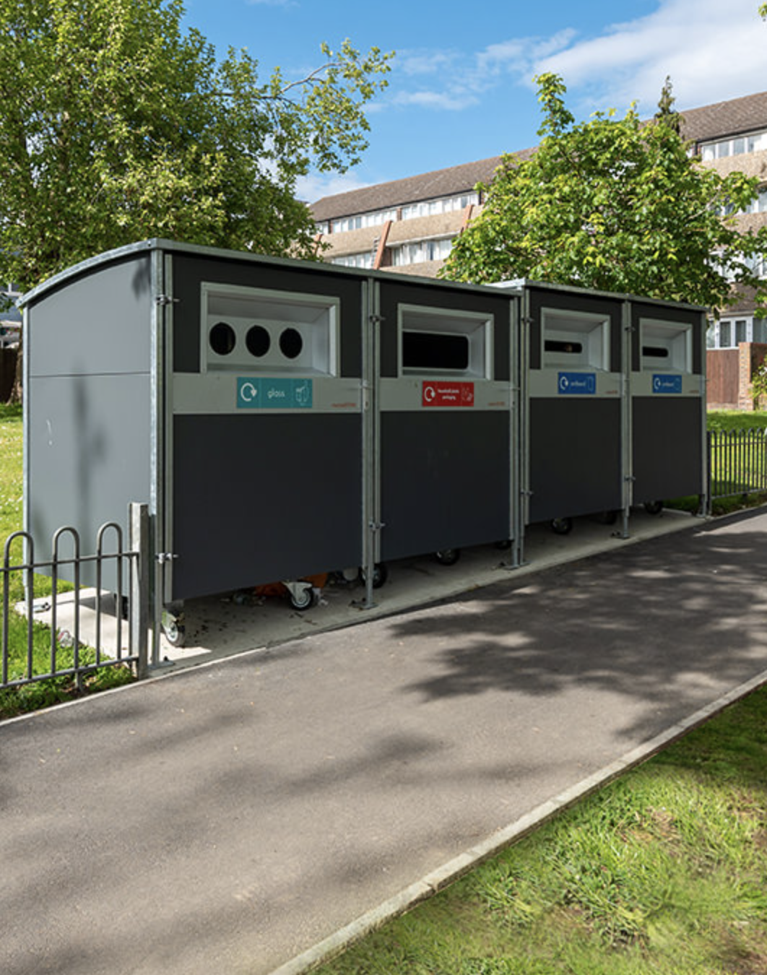
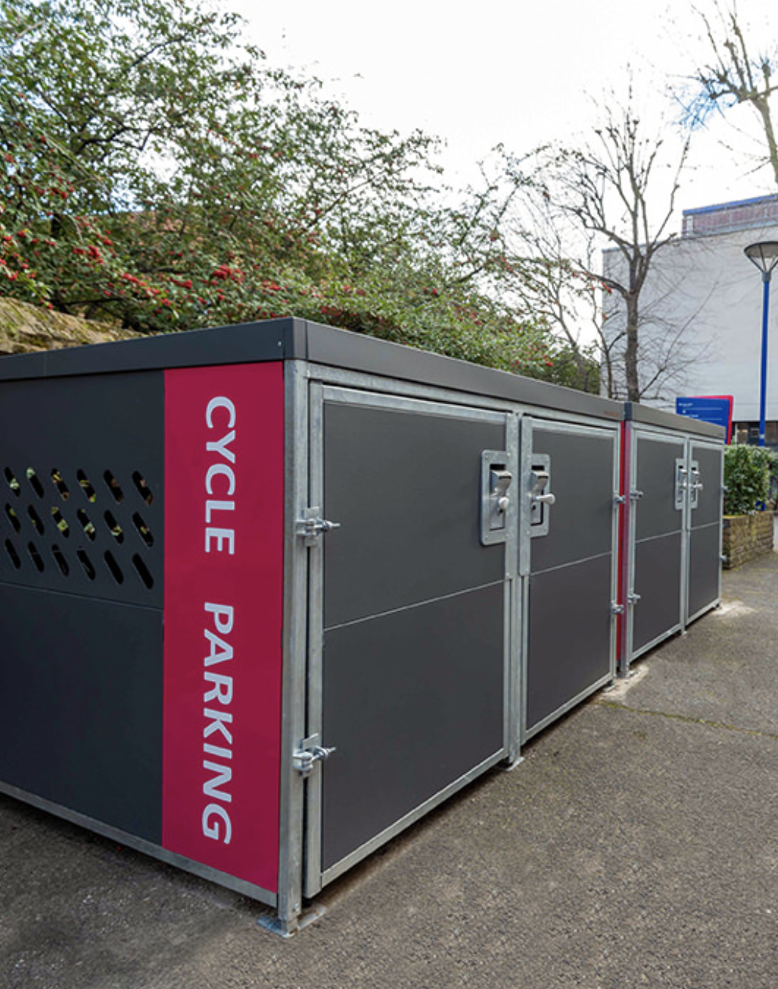
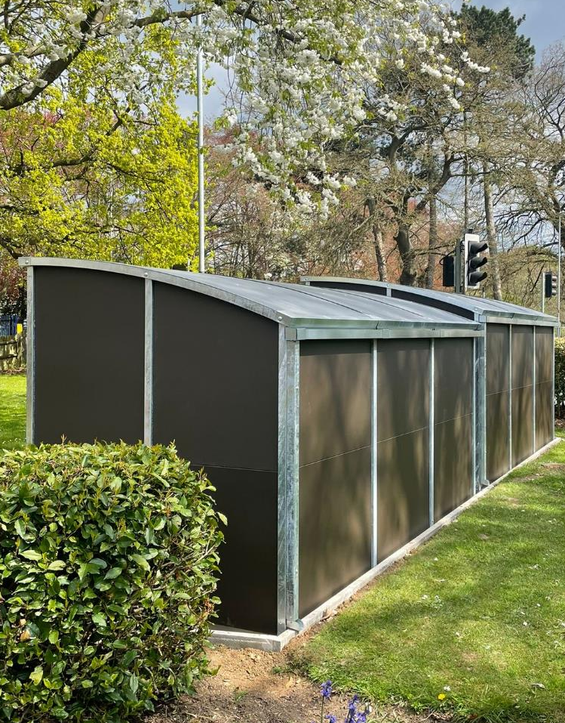
15,000 units installed, 60,000 safer homes…
Waste & Recycling
Cycles
Powered Mobility

Slide 3
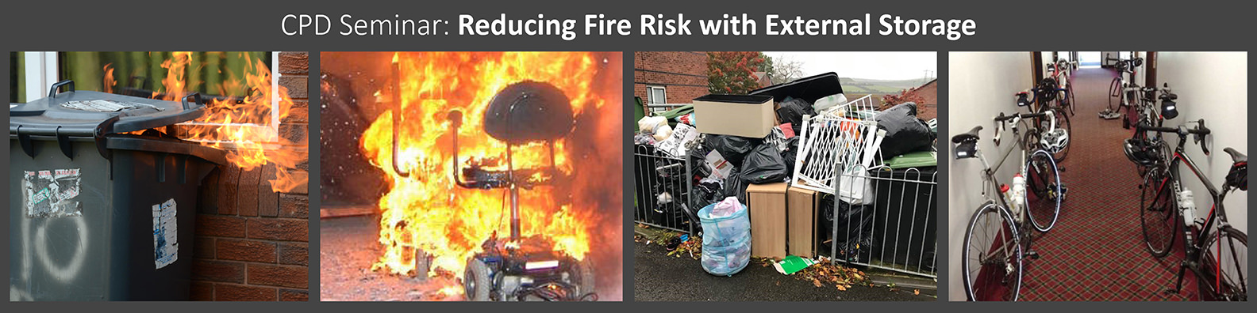
What fire risks can we eliminate with external storage?
Refuse fires
Mobility fires
Fly-tipping
Communal areas

Slide 4
Waste & Recycling

Slide 5
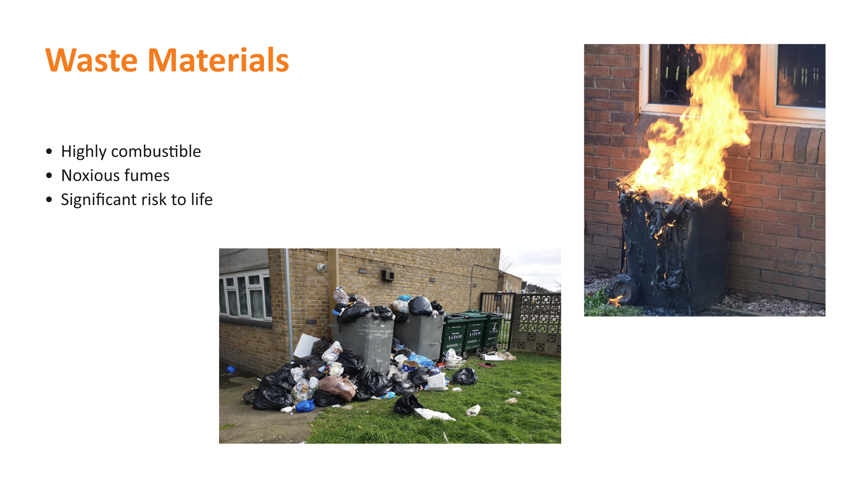
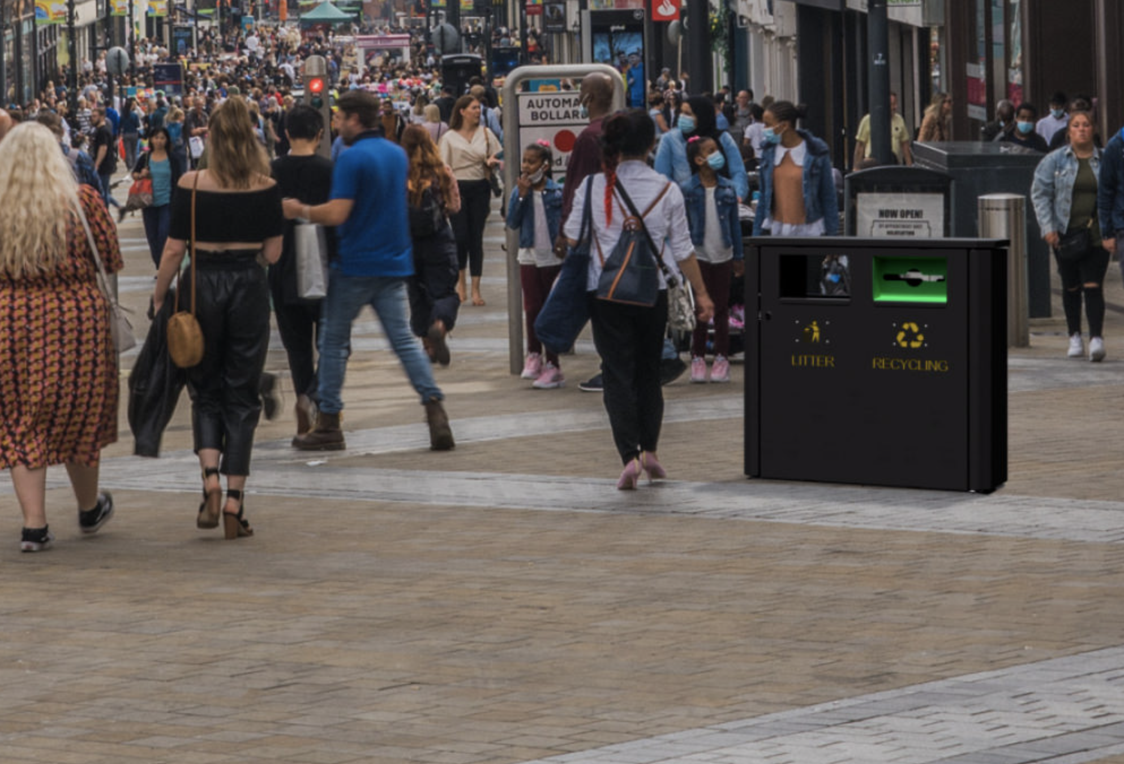
Waste Fires
50,000 incidents/year
Frequently involved at source
Highly-combustible
Toxic Fumes

Slide 6
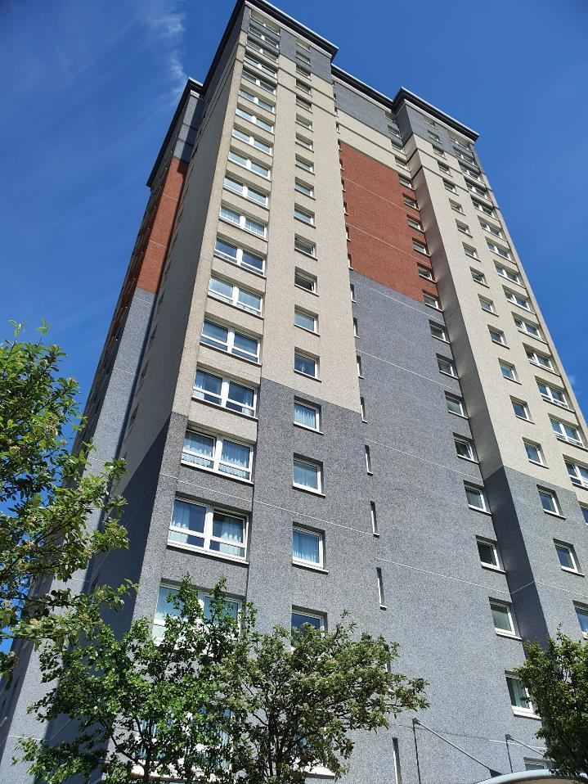
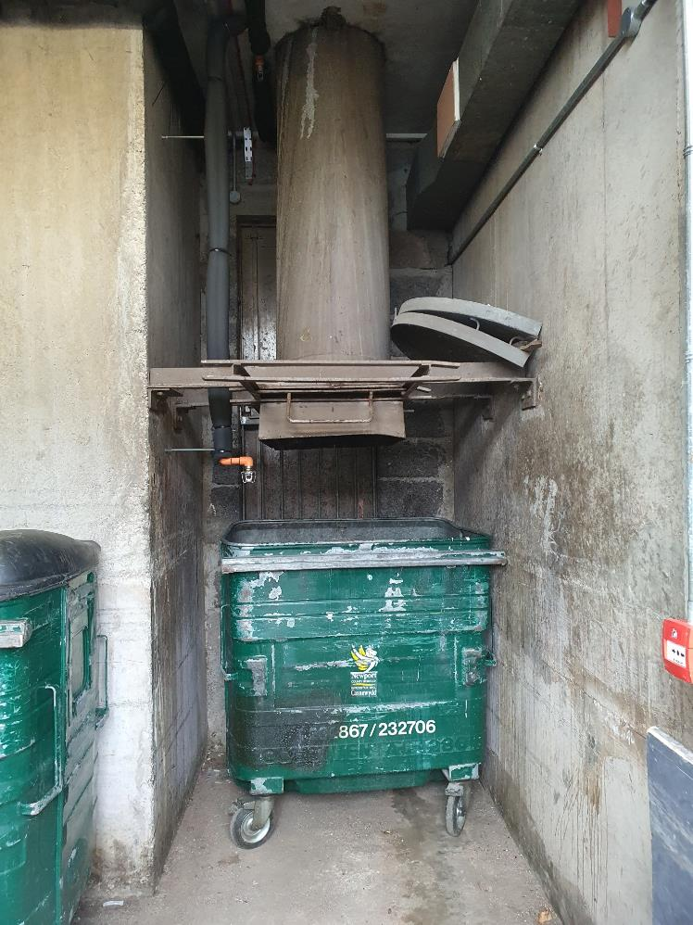
Internal Waste Storage
Fire Risk
Maintenance
Blockages
Odour
Sidewaste

Slide 7
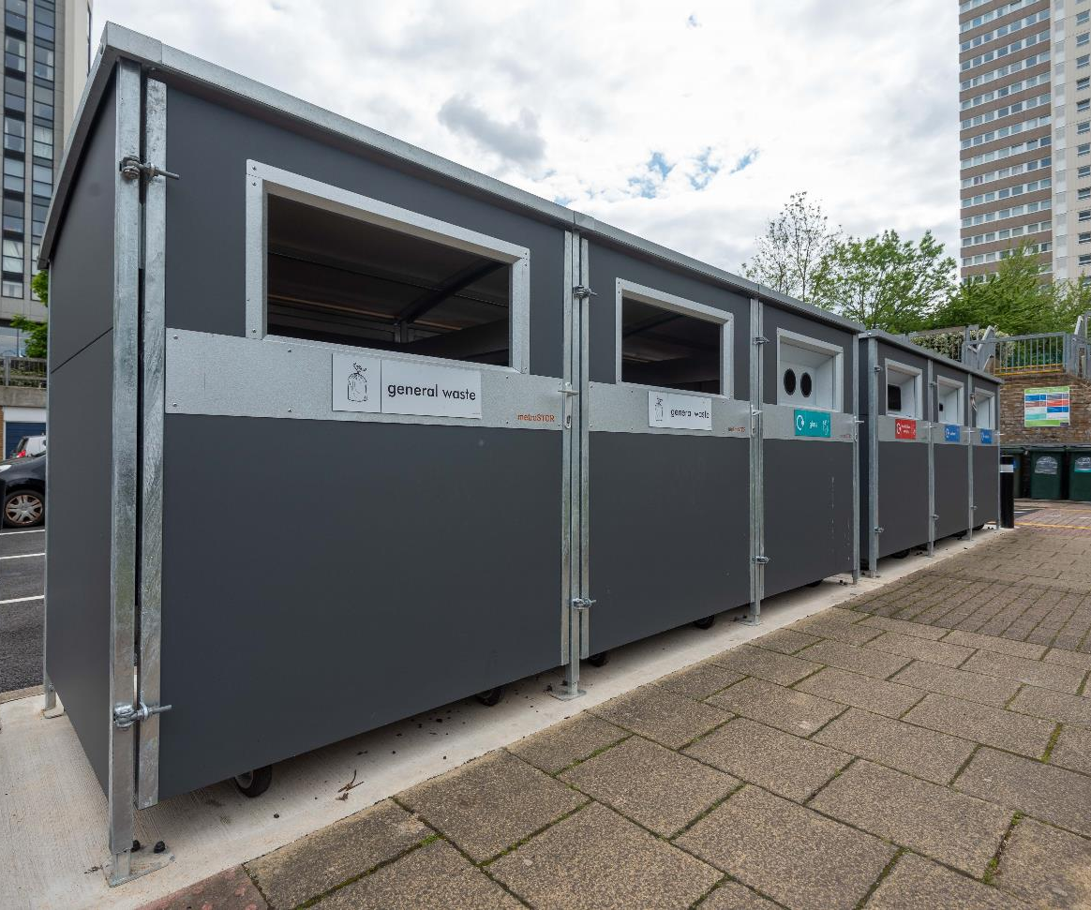
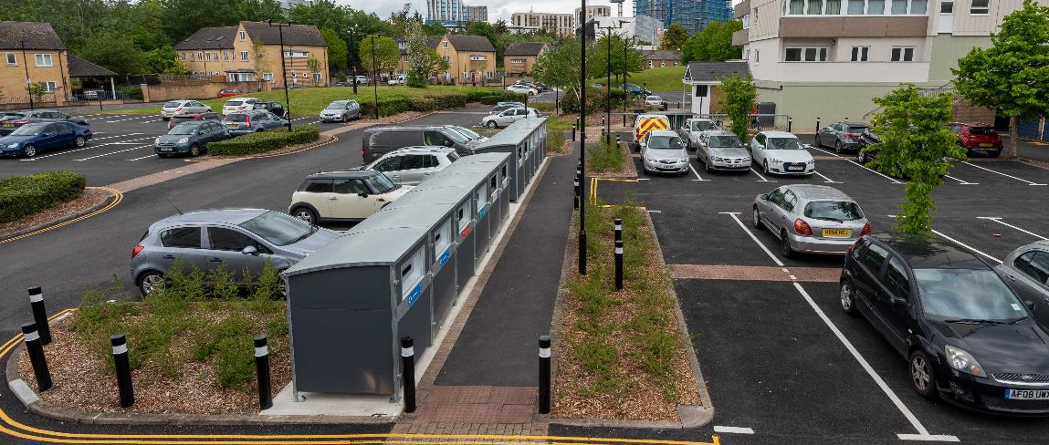
Change to External Storage
Brentford Towers, Hounslow
Eliminated Fire Risk
No bags on landings
Quadrupled recycling

Slide 8
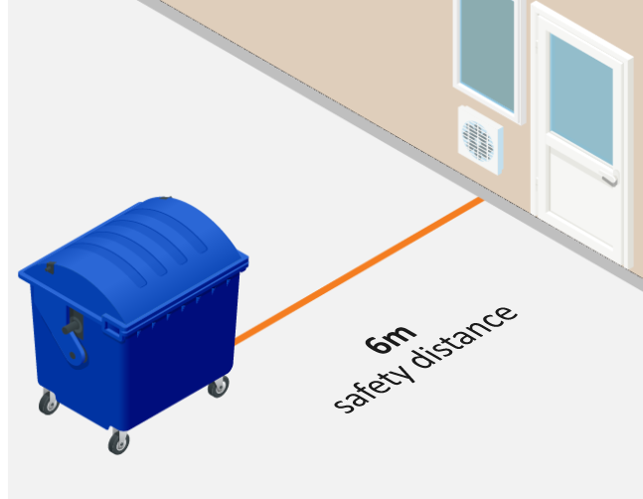
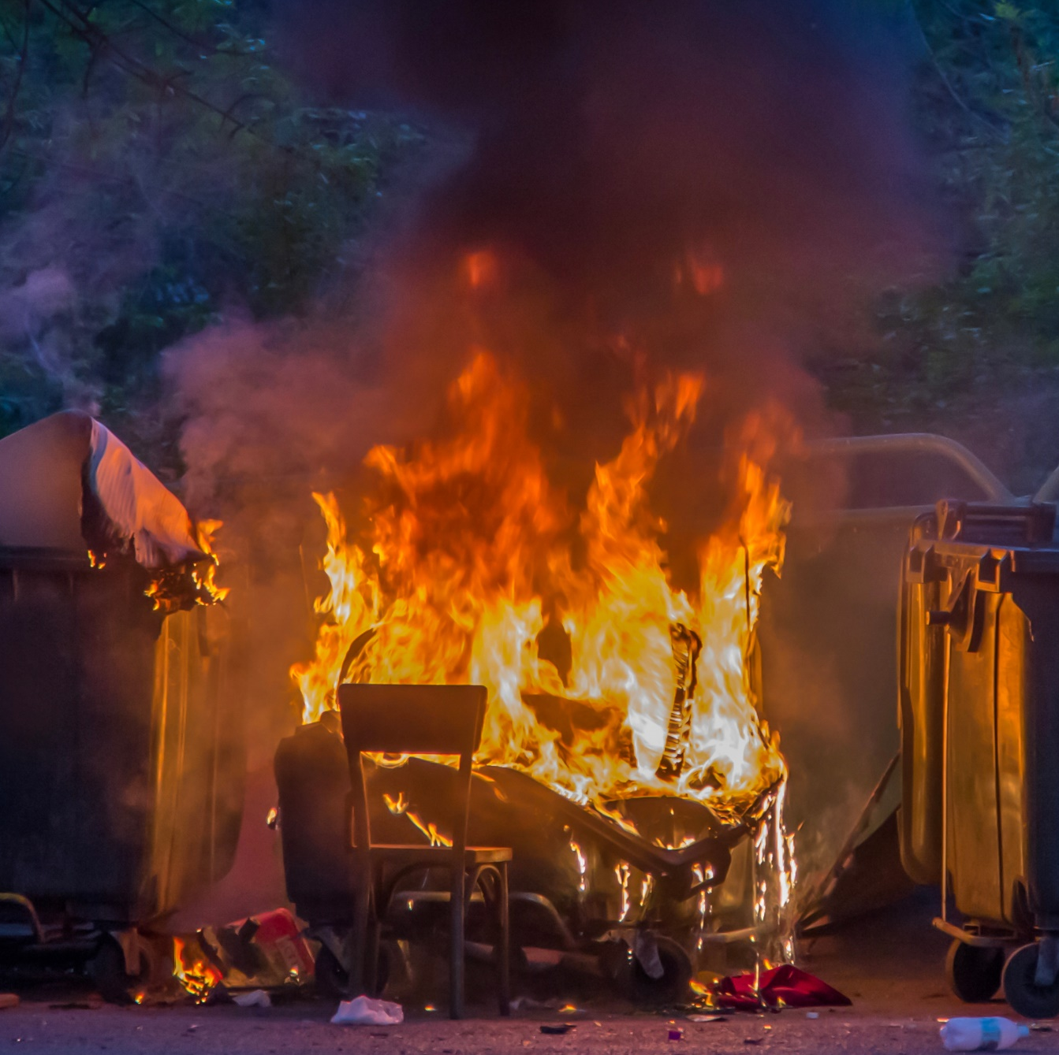
Fire Safety
1
CFPA-E Guidance
Safety Distance between Waste Containers and Buildings
2
6m from Building Openings or 30min Fire Resistance
3
metroSTOR Fire Testing
1100L Recycling Bin – 90min

Slide 9
Powered Mobility

Slide 10
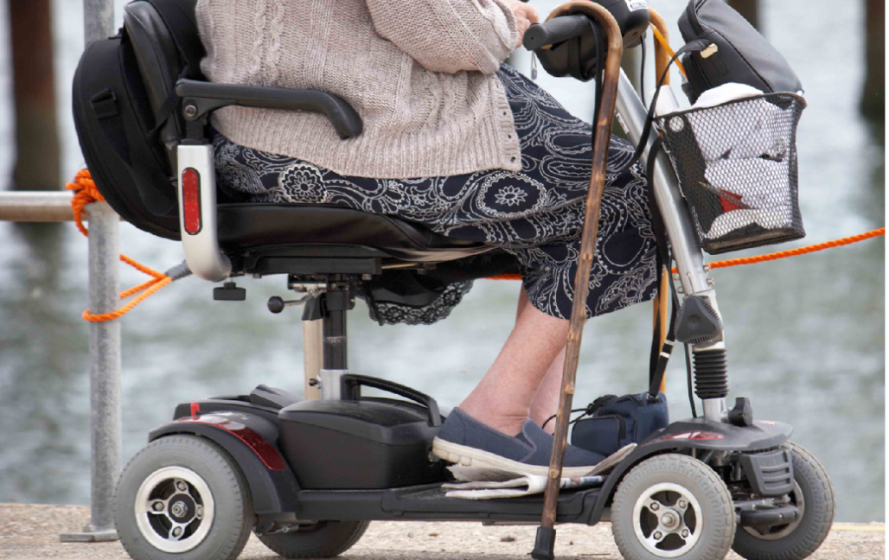
Mobility Scooters
Independence
NFCC Guidance
Hierarchy of control
Accessibility
Charging/storage

Slide 11
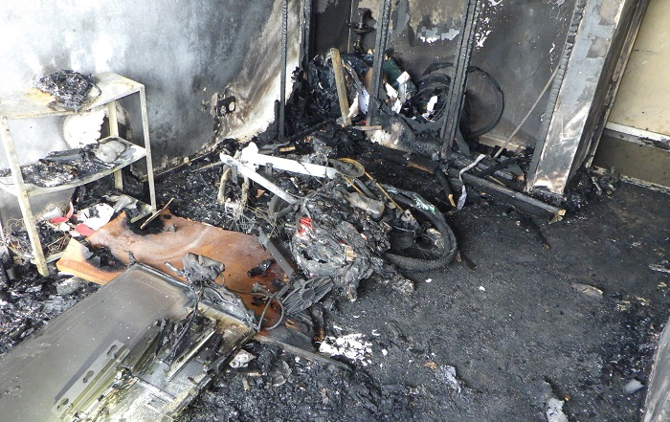
E-bikes / Scooters
Lithium-ion batteries
Thermal runaway
Extinguishing
Policy statement
Charging/storage

Slide 12
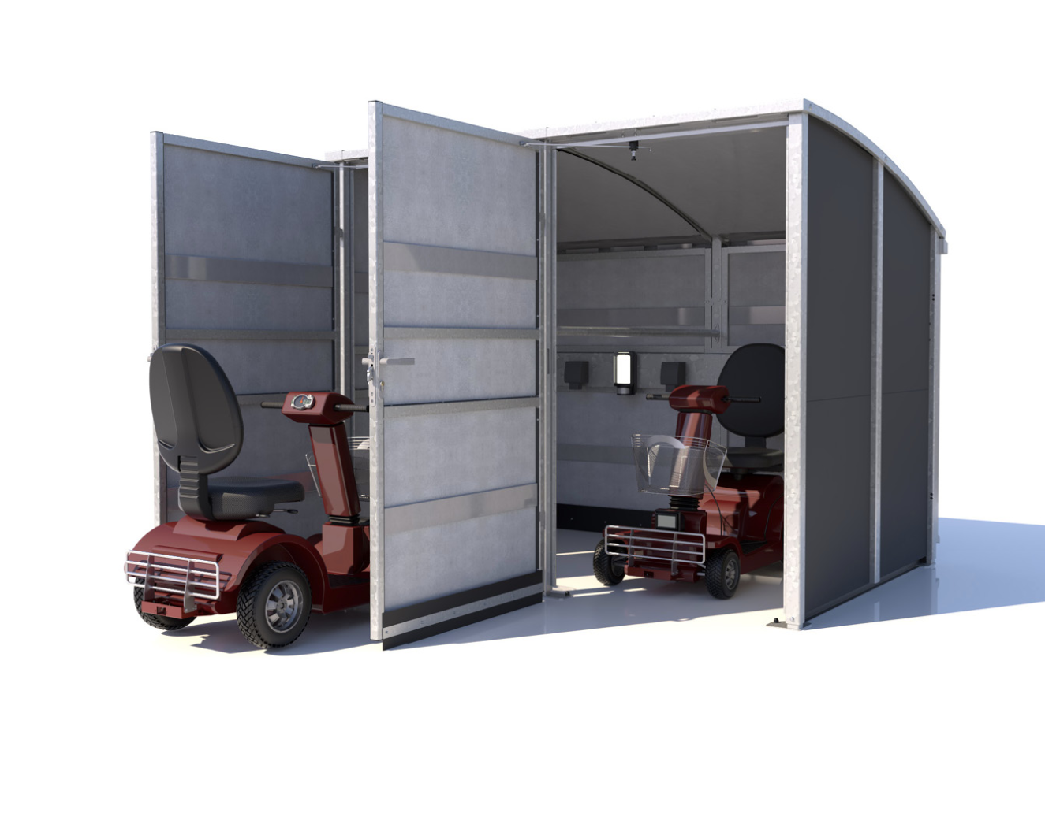
External Stores
Secure
Fire-resistant
Accessible
Weatherproof
Charging / lighting

Slide 13

Notes:
Clear framework to successfully deal with the fire risks
Waste and recycling bins, mobility scooters and bicycles
Challenging to get right solution
Following these simple steps will guarantee a successful outcome
Any questions, please?

