Slide 1

Building Safety Masterclass
Procurement and how it is changing

Slide 2
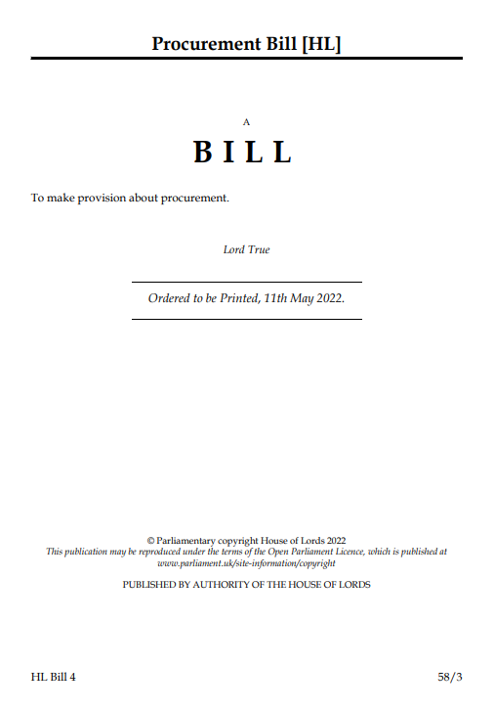
Introduction
Introduction to the Echelon Group
Introduction to the Procurement Bill
What’s in it – a whistlestop tour!
Impact
Next Steps
Questions?

Slide 3
Introduction to Echelon

Slide 4


About Us
Formed in 2005
Comprises 3 wholly owned subsidiaries:
  Echelon Consultancy – procurement and asset management consultancy
  Pretium Frameworks – manages Frameworks for CAs
  EIP – runs AMIP Best Practice Groups,
  Sub-Groups and Conference
One of responders to Green Paper
Will be rolling out training as Bill becomes Act
20+ current procurement exercises

Slide 5
The Procurement Bill

Slide 6
Why is it Needed?
Current Public Contracts Regulations 2015 include EU requirements
Kept in place under the Withdrawal Act 2018
Objective to speed up and simplify, value for money, generate social value and make more accessible to SMEs and Charities
Also combines three separate current sets of Regulations (PCR, Utilities and Concessions) into one
Importantly, has to be reflective of World Trade Organisation's Agreement on Government Procurement

Slide 7
How?
Cabinet Office issued Green Paper (Transforming Public Procurement) in December 2020
Objective to speed up and simplify, value for money, generate social value and make more accessible to SMEs and Charities
Consultation with 500+ stakeholders
Open consultation undertaken – 619 responses received (including ours ☺) – only 20 Housing Associations
Lukewarm response from procurement professionals

Slide 8
Procurement Bill
A Whistlestop Tour

Slide 9
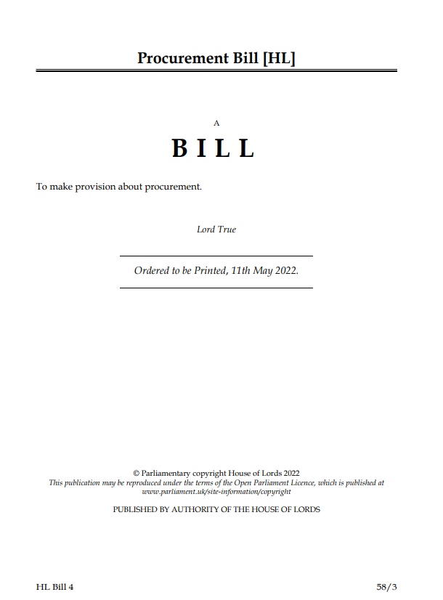
Structure of Bill
Bill has 116 clauses over 6 chapters
112 pages
Explanatory Notes also published
Also contains 11 Schedules, including thresholds (Schedule 1)

Slide 10

A Simpler Framework
Bill repeals all existing regulations into single framework
Some of the differences applying to concessions, utilities and defence will remain
Maintains concept of a CA (slightly tweaked), types of contracts that must be advertised & thresholds

Slide 11

Principles & Objectives
Maintains principles of transparency, equal treatment and non-discrimination
New requirements including value for money, maximising public benefit and integrity
Most Advantageous Tender replaces Most Economically Advantageous Tender
Bill allows Minister ability for Govt to publish strategic statements, which CAs must regard

Slide 12
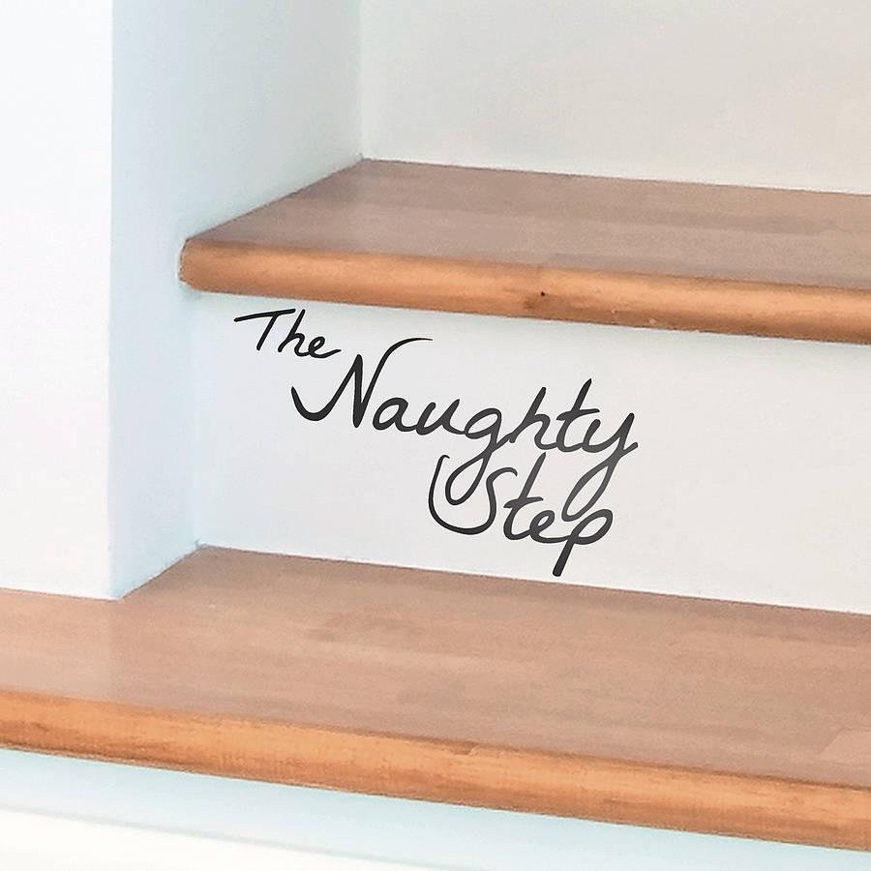
Policing Procurement
New Procurement Review Unit (PRU) created
Sits within the Cabinet Office made up of civil servants (advised by a non-statutory panel of subject matter experts)
PRU’s main focus will be on addressing systemic or institutional breaches of the procurement regulations
Legislation will be implemented to give PRU “limited powers”

Slide 13

Procurement Options
There will be 3 options in the new Regulations
A new flexible procedure that gives buyers freedom to negotiate and innovate to get the best from the private, charity and social enterprise sectors.
An open procedure that buyers can use for simpler, ‘off the shelf’ competitions.
A limited tendering procedure that buyers can use in certain circumstances, such as crisis or extreme urgency.

Slide 14



Competitive Flexible Procedure
‘Minimal detailed rules’
Similar to current ‘light touch’ regime
Replaces 5 current procedures (Restricted, CD, CPN, Innovation and Design contests)
Only other real option will be ‘Open’

Slide 15


Competitive Flexible Procedure
Gives CAs flexibility in procurement process
Must be proportionate
Can limit suppliers generally or in rounds
Award criteria can be refined (as long as not discriminatory and must be republished)
More grounds for exclusion
Can restrict number of Lots awarded
So, what will it look like?

Slide 16
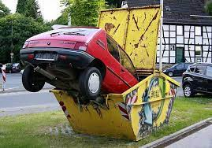
It could be….
  Unfamiliar to buyers and suppliers and could result in familiarisation costs and time to bed in
  Buyers may choose to not take advantage of the increased flexibility and revert to traditional methods
  Increased flexibility may result in greater divergence across buyers, limiting the extent to which standard approaches are developed and increasing the overall time and cost of procurements due to poor practice
  Greater use of negotiations could prolong procurement timescales and the possibility of negotiation later in a procedure may cause suppliers not to put their best proposals forward in initial tenders
  An increased number of legal challenges as the new procedure is tested.

Slide 17

Or…..
More consideration given to procurement
Design of processes that are matched to what’s being procured
Will drive more planning and market engagement
More flexibility and iterative models

Slide 18

Open Procedure
Open procedure retained as a standard procedure
While it would be possible to undertake a process akin to the open procedure through the new competitive flexible procedure, open procedure retained in its own right
It is currently the most popular procedure and will continue to be appropriate for simple requirements where an initial selection stage is not needed
It will also be useful to have a default standard procedure for inexperienced buyers
Will it be misused though??

Slide 19

Limited Tendering Procedure
Basically renamed ‘negotiated procedure without prior publication’, criteria:
  absence of tenders or suitable tenders in an advertised procurement;
  artistic reasons, technical reasons or exclusive rights;
  extreme urgency;
  for the purchase of research and development goods;
  additional purchase of goods where a change in supplier would result in technical difficulties;
  purchase of goods on commodity markets;
  purchase of goods on advantageous terms due to winding up or bankruptcy;
  design contests (will be removed as the procedure will cease to exist);
  repetition of works and services in limited circumstances.
Also adds grounds of ‘crisis or extreme urgency’ – nod to COVID

Slide 20

Transparency – CA Publications
CAs spending >£100m per annum required to publish a ‘Pipeline Notice’
Tender notice at commencement of process
More detailed information about the evaluation to unsuccessful bidders
Contract award notice before (instead of after) entering into a public contract
Information about contracts after they have been concluded
Copy of any public contract with a value exceeding £2 million within 90 days of it being entered into

Slide 21
Transparency – CA Publications
Information about payments under public contracts to enable scrutiny by the general public
Contract implementation notice to update on performance against KPIs
Contract change notice in advance of implementing amendments
Contract termination notice ahead of the expiry or termination of a contract

Slide 22

Market Engagement
Encourages preliminary engagement
Can include co-production of specifications etc.
Cannot give any supplier an advantage
Can publish a ‘Pre Market Engagement’ Notice
Fully embrace this, especially in current climate

Slide 23

Exclusion
Similar grounds as currently:
An ‘excluded supplier’: a supplier which meets a mandatory exclusion ground and where the CA considers that the circumstances giving rise to the ground will reoccur; or
an ‘excludable supplier’: a supplier which meets a discretionary exclusion ground and where the CA considers that the circumstances giving rise to the ground will reoccur.
New exclusion grounds published – worth a read!

Slide 24
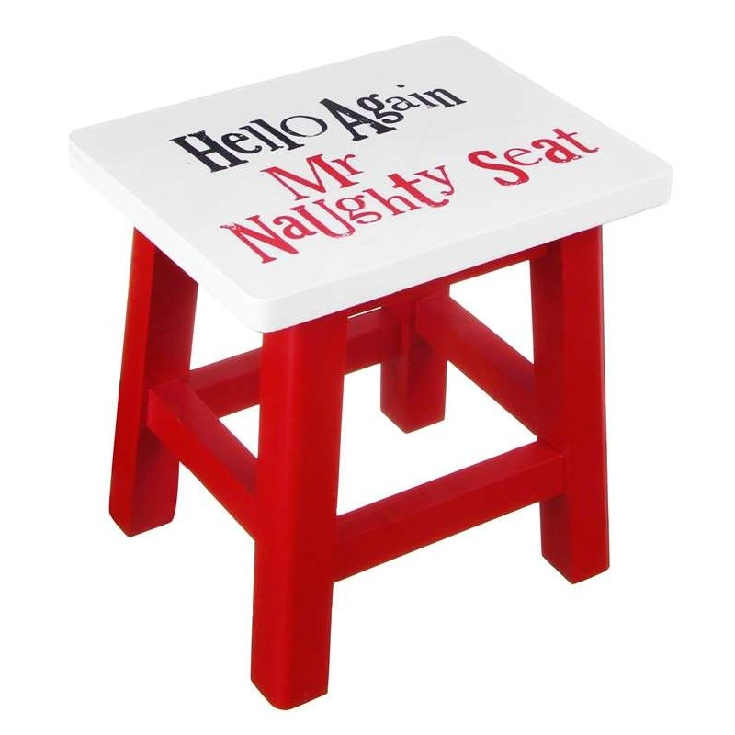
Debarment List
Creation of central debarment list
CAs required to notify Minister when a supplier is excluded
Minister then considers whether to include
Must state reasons and notify prior to publication (with appeal right)
Ability to request removal once published

Slide 25

Registration
All CAs required to use single digital platform for supplier registration
Significant amount of data will only need to be entered annually
Should make pre-qualification process easier
Focus will be on qualitative
Welcomed, but how long will it take to implement?

Slide 26
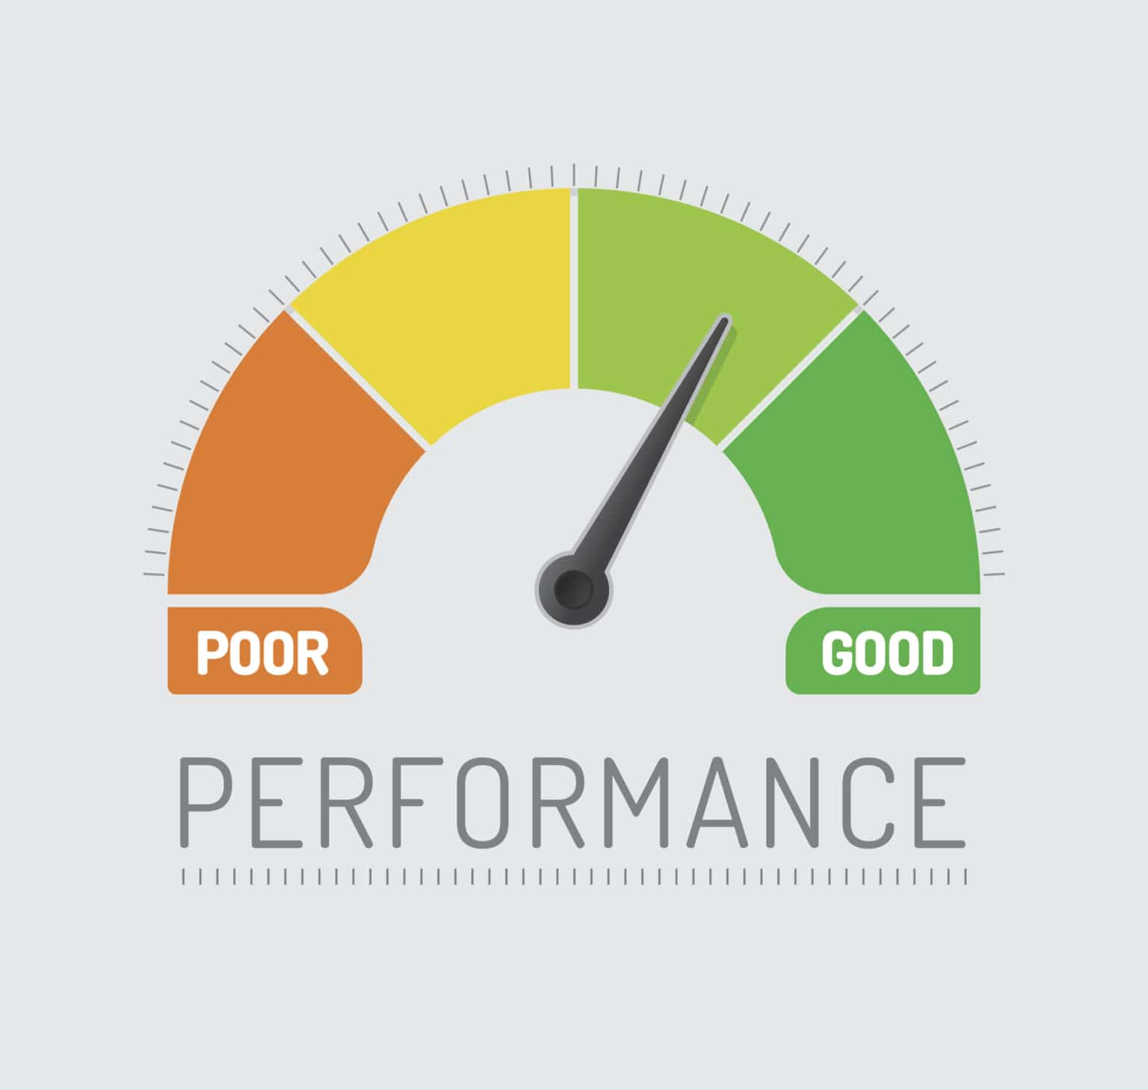
KPIs and Performance Reporting
Applies to contacts with value >£2m
CA must ‘set and publish at least three KPIs in respect of contract’
Performance reported at least annually
CA obliged to publish termination notice
CA can opt out if they believe performance cannot be ‘appropriately’ be assessed by KPIs
Doesn’t apply to Frameworks

Slide 27

Frameworks – What’s New?
Existing 4-year framework retained as ‘closed’ framework
New ‘Open’ framework created
Effectively creates successive frameworks
Must be reopened after the first 3 years and at least every 5 years after – therefore could be opened annually if required
Maximum period of 8 years (single supplier <4 years)
Minimum number of open framework is 2
Fee can only be generated based on throughput

Slide 28

DPS’s – What’s New?
DPS replaced by Dynamic Markets
Can be used for all types of contracts
No limit on duration of Dynamic Market
No direct award criteria
Will still require constant administration
Will this become a more popular option?

Slide 29

Modifying Contracts
Requirement for CA to publish ‘Contract Change Notice’
Voluntary standstill period prior to implementing modification
Substantial change to term now defined as >10%

Slide 30
Assessment Summaries
CA must publish Contract Award Notice prior to entering contract
CA obliged to provide ‘Assessment Summary’ to all suppliers
Should include information on CAs assessment of the tender and the differences between the most advantageous

Slide 31

Remedies Rules
Mandatory standstill period now 8 working days
Automatic suspension also applies to modifications
Only applies if claim made during standstill period
New set aside remedy included – with new criteria
Includes where required notices not published and where breach becomes apparent after award/modification

Slide 32

Payments
Proposals to tackle payment delays included
Additional requirement that subcontractors evidence actions escalated to CAs have been implemented
Further guidance on how payment complaints can be escalated to follow
Likely to be ‘spot checks’

Slide 33
Considerations?

Slide 34

Impact?
More emphasis on market engagement
Over use of open procurement process
Creation of myriad of different approaches
Management of disbarment list
Introduction of KPIs
Impact of poor performance – disbarment?

Slide 35
Next Steps

Slide 36
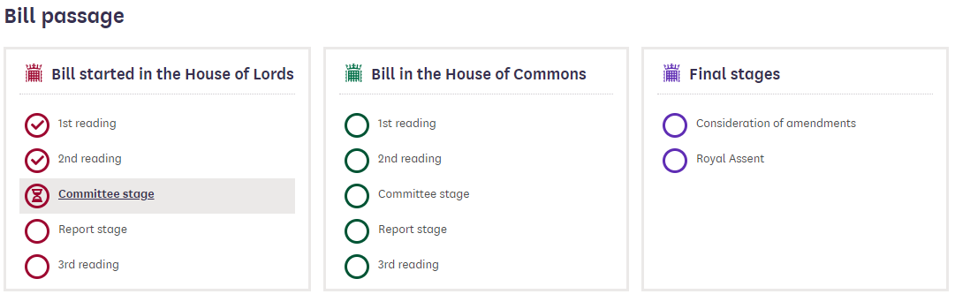
What Happens Next?
Introduced in May 2022 Queen’s Speech
Currently at Committee Stage in the Lords (after two readings)
‘Detailed and comprehensive’ package of published resources to be published (included templates and model procedures)
Six months notice of ‘go-live’ will be given once legislation concluded
Not in force until 2023 at the earliest (and then 6 months grace)

Slide 37

Questions?

Slide 38

Contact

