Slide 1
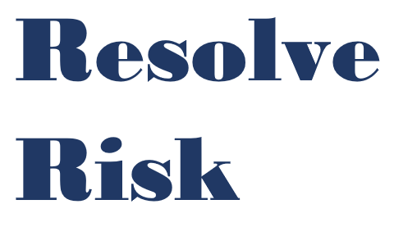

Competence under the new regime
PAS 8673:2022
Anthony Taylor
anthony.taylor@resolvegroup.co.uk
www.resolvegroup.co.uk
www.resolvegroup.co.uk

Slide 2
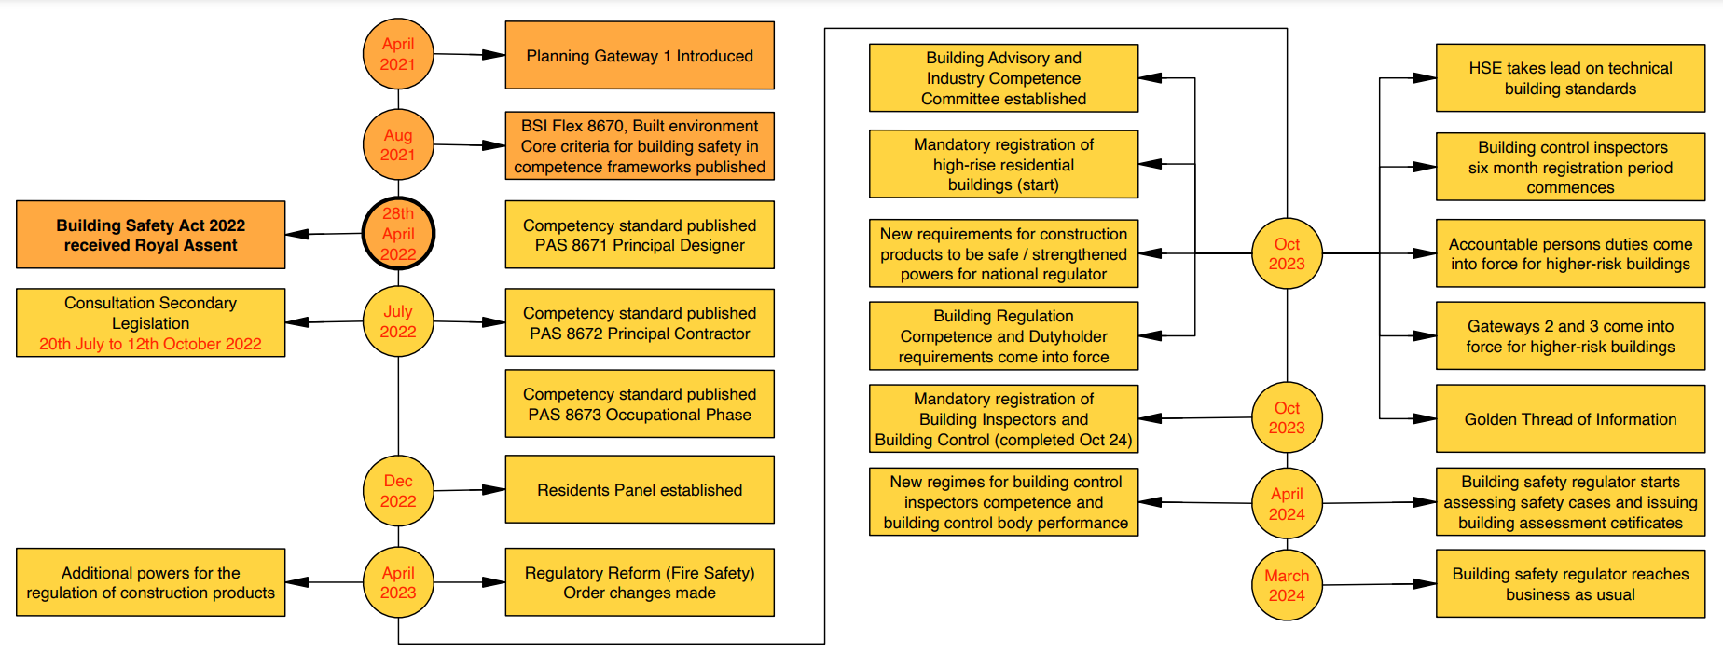
Timeline for Regulations
Resolve
Risk
www.resolvegroup.co.uk

Slide 3
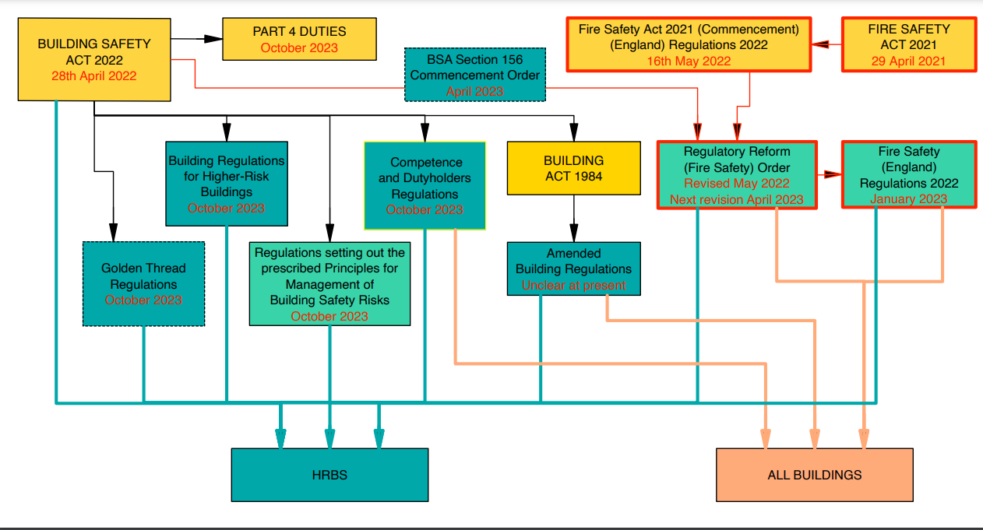
BSA/FSA interaction
Resolve
Risk
www.resolvegroup.co.uk

Slide 4

Competence
We will promote competence among industry professionals and regulators to raise standards in design, construction and the management of buildings
Competence includes the competence of regulators, such as Building Control
We are working with organisations, including the BSI, to design the competence framework
​

Slide 5
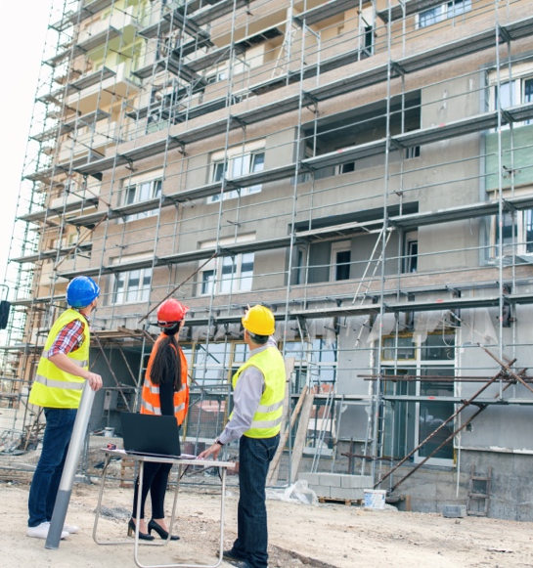
C-O-M-P approach to competency
C – Comprehended. Ensure stakeholders know their relevant competency requirements
O - Obtain Encourage stakeholders to obtain the necessary training and upskilling.
M - Measure. Support measures that prove or demonstrate the required levels of competence
P - Perform. Encourage those with the required competency to perform to the expected standards.

Slide 6

(Interim) Industry Competence Committee (IICC)
(I)ICC takes a strategic overview of competence, delivering a leadership role, to become the authoritative voice of competence in industry.
The committee will visibly drive competence forward to support immediate changes in culture and uptake of training for key roles
Implement a “path to culture change” through a longer term strategy to run over the next two, five or even 10 years.”
Monitor the uptake of competence, and the creation of new training opportunities.
Notes:
​

Slide 7
ISSG & CSG
Industry Safety Steering Group (ISSG), chaired by Dame Judith Hackitt, established (1 October 2018) to provide support and constructive challenge to industry, and to determine actions for tackling blockages and accelerating culture change in the construction industry. The Group will be responsible for highlighting progress and action that industry is taking and holding industry to account for progress made in implementing the changes Dame Judith identified.
Industry set up a Competence Steering Group + Working Groups (x12) in June 2018: July 2021 Interim Industry Competence Committee (IICC) created by Regulator
CSG reported on the progress of work to the Industry Safety Steering Group (ISSG) and to the Industry Response Group (IRG, which formally established the CSG).
  WG0 Governance Structure
  WG1 Engineers
  WG2 Installers
  WG3 Fire Engineers
  WG4 Fire Risk Assessors
  WG5 Fire Safety Enforcement Officers
  WG6 Building Standards
  WG7 Building Designers
  WG8 Building Safety Managers
  WG9 Site Supervisors
  WG10 Project Managers
  WG11 Procurement Professionals
Resolve
Risk
www.resolvegroup.co.uk

Slide 8
Building Safety Act
Part 3 – Construction/New Build/Refurbishments
    All new building work
Part 4 - In Occupation
  In scope buildings HRBs residential part of buildings 18M/7 Storeys high with two or more occupied units – one to be occupied
  A building safety risk is a risk to the safety of people in or about a building arising from any of the following occurring as regards the building:
    (a) the spread of fire;
    (b) structural failure;
    (c) any other prescribed matter.
Resolve
Risk
www.resolvegroup.co.uk

Slide 9
Construction Work
The new regulatory regime will regulate and hold to account those participating in the design and construction of new buildings, and the refurbishment of existing buildings.
The regulations will apply to all building work, and all persons participating in that building work. The provisions will also apply to those appointed under the Construction (Design and Management) Regulations 2015 (CDM) when CDM applies to the building work. Those appointed under CDM 2015 will be deemed appointed under the building regulations.
The provision will ensure that when buildings are designed, constructed or refurbished, all dutyholders, including existing dutyholders identified in CDM 2015, will have formal responsibilities for compliance with building regulations.
New Dutyholders
  Client
  Principal Designer
  Principal Contractor
Resolve
Risk
www.resolvegroup.co.uk

Slide 10
Appointment by PAP for others to assist in fulfilling ‘Part 4 Duties’
Many PAP/APs may not have the competence/resources to undertake and deliver their duties
It is anticipated that many will contract with others (eg Managing Agents) to assist
    Terms of Contract arrangements?
      Regulations (Part 4 duties) Only
      Regulations +?
      Regulations ++ ?
Residential Management Companies (RTM) and similar organisations now facilitated to engage a third party ‘Safety Director’
Anyone, (including organisations) appointed by the PAP/AP/RTM to undertake works will need to assure themselves they are competent to deliver the work and the ‘client’ will need to assure themselves that those they appoint are competent to undertake the work.
PAS 8673 anticipates a competent ‘senior manager’ within the organisation to be in place with overall responsibility to manage the resources necessary to deliver on ‘Part 4’ - the organisation will need ‘access to competent advice’
Where the work is undertaken ‘for & behalf of’ it may be that both supplier and PAP/AP will require assurance process
Resolve
Risk
www.resolvegroup.co.uk

Slide 11
Competence & Culture Change
Current culture is to hire a contractor/consultant and to readily accept what they say – everything needs to be tested against the design of what ever is being applied/constructed – this is the evidence that the agreed safe design has actually been installed. You need the Design Drawing, (in accord with Building Regs:) and evidence of appropriate components and assurance that all is installed correctly in accordance with the design.
Fire Risk Assessor competence will be mandated once section 156 of the Building Act is made live (April 2023)
  NFCC will issue guidance as to where to find competent persons
Note: Anecdotally, a disappointingly high proportion of Gateway 1 ‘Fire Statements’ have failed due to lack of evidence of why and how it is compliant
Resolve
Risk
www.resolvegroup.co.uk

Slide 12
Competence
“competence” is a requirement relating to—
  (a) the skills, knowledge, experience and behaviours of an individual;
  (b) the capability of a person other than an individual to perform its functions under building regulations.
  (3) The regulations may require an appointed person who is not an individual to give an individual acting under its control who has the appropriate skills, knowledge, experience and behaviours the task of managing its functions as an appointed person.”
an overarching competence framework standard (BSI Flex 8670 Built environment – Overarching framework for competence of individuals) for everyone working on a building. The framework sets core principles of competence, including leading and managing safety, communicating safety, delivering safety, risk management, regulations & processes, building systems, ethics, and fire/life safety. Work now started on conversion to a full standard
a set of competence requirements for the new roles:
  PAS 8671 PD
  PAS 8672 PC
  PAS 8673 Those responsible for managing safety in residential buildings
Resolve
Risk
www.resolvegroup.co.uk

Slide 13
BECS programme of standards development 2020-2022
Building Safety Competence criteria
Guidance?
Principal Designer Competence Framework
PAS 8671
Principal Contractor Competence Framework
PAS 8672
Management of Safety in Residential Buildings
Competence Framework
PAS 8673
CSG and other
industry activity
BECS Strategy Group –> Technical Committee CPB/1
Sector and sub-sector frameworks
Resolve
Risk
www.resolvegroup.co.uk
Notes:
BSI tasked with developing “industry developed competence frameworks and schemes”
Plus others expected e.g. Building Control, supplementary docs, …
As we roll out the implementation of the documents gaps will emerge, further needs, thinking moves industry docs to formal standards

Slide 14
PAS 8673:2022 Built environment – Competence requirements for the management of safety in residential buildings – Specification
Competency Standards
The government has been working with the British Standards Institution (BSI) to create a suite of national competence standards for duty holders.
These include which came into effect on the 31st July 2022.
PAS 8673:2022 sets out a competence framework to support Accountable Persons and others in managing building safety risks.
The PAS is intended to apply to both organisations and to individuals, especially those overseeing the implementation of the arrangements to assess and manage building safety risk
The minimum competence requirements within the PAS are intended to be interpreted in the context of the functions, activities and tasks relevant to the management of safety in residential buildings.
Overseeing the arrangements to manage building safety risks is a highly important role and requires an effective safety management system to be evaluated and implemented or managed. Any person, including where part of an organization, who undertakes this overseeing role is, therefore, expected to have the relevant skills, knowledge and experience, combined with appropriate behaviours as set out in Table 1 of BSI Flex 8670 v3.0:2021-04 Built environment. Core criteria for building safety in competence frameworks. Code of practice
Resolve
Risk
www.resolvegroup.co.uk

Slide 15
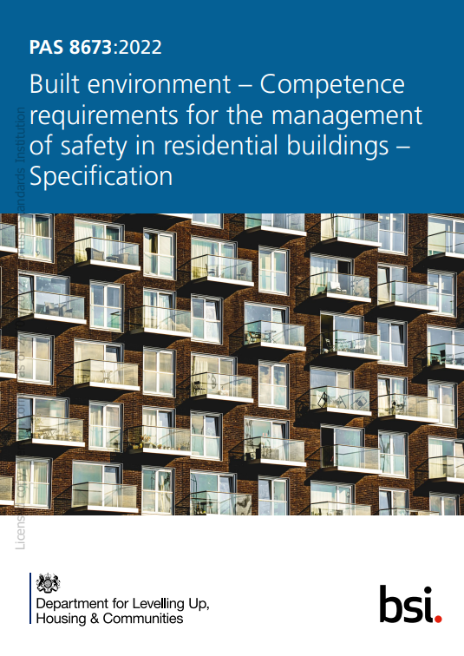
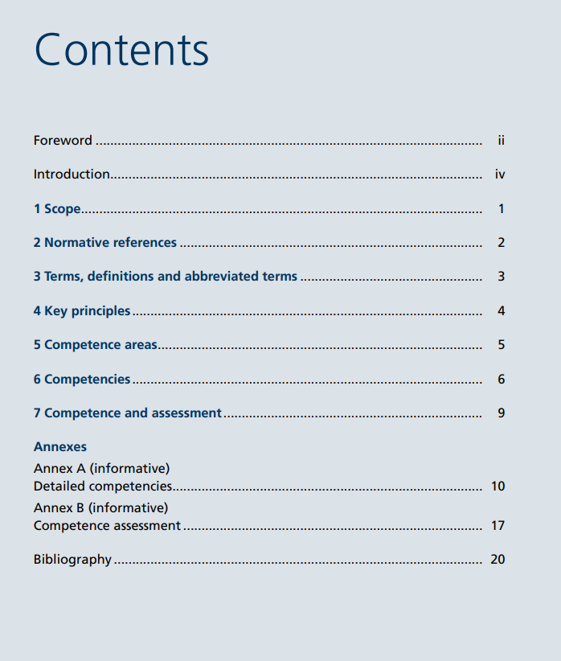
PAS 8673:2022
Resolve
Risk
www.resolvegroup.co.uk

Slide 16
PAS 8673 - Relationship with other publications
This PAS forms part of a comprehensive suite of documents relating to competence in the built environment.
The suite comprises:
BSI Flex 8670, Built environment – Core criteria for building safety in competence frameworks – Code of practice) ;
PAS 8671, Built environment – Framework for competence of individual Principal Designers – Specification;
PAS 8672, Built environment – Framework for competence of individual Principal Contractors – Specification;
PAS 8673, Built environment – Competence requirements for the management of safety in residential buildings – Specification.
This PAS is based upon the recommendations regarding competence (i.e. skills, knowledge, experience and behaviours) and assessment given in the report Safer people, safer homes: Building Safety Management of Working Group 8 [1], the “Hackitt” report [2], and BSI Flex 8670
Resolve
Risk
www.resolvegroup.co.uk

Slide 17
PAS 8673: 2022 - Forward
This PAS sets out a competence framework to support Accountable Persons and others in managing building safety risks. “Building safety” is used in the sense defined in BSI Flex 8670 and encompasses fire safety, structural safety, public health and public safety.
The context of the PAS is residential buildings and other developments incorporating residential accommodation, but it might also be relevant to other types of building. The term “person” in this PAS means a natural person or a legal entity, i.e. organization.
Resolve
Risk
www.resolvegroup.co.uk

Slide 18
PAS 8673: 2022 - Forward
This PAS can be used as a benchmark against which to assess the competence of:
those performing the necessary activities related to the management of building safety in residential buildings; and
those whose services are being contracted to carry out or support the carrying out of the management of building safety.
It can also be used to guide and assess how well dutyholders and those delegating functions to others (for example, a managing agent employing specialist contractors) have carried out due diligence to verify the competence of those they employ or contract
Resolve
Risk
www.resolvegroup.co.uk

Slide 19
PAS 8673: 2022 - Foreward
More generally, it is expected to be of use to, for example:
organizations that will assess the competence and commitment of persons managing safety in residential buildings, including professional bodies, trade bodies and those that regulate by statute or facilitate voluntary self-regulation;
national accreditation authorities;
government agencies;
employers; and
insurers.
It is anticipated that this PAS can be used to assure stakeholders that persons managing safety in residential buildings are assessed by common and directly comparable methodology and processes.
Resolve
Risk
www.resolvegroup.co.uk

Slide 20
PAS 8673: 2022 - Introduction
The interdependencies that exist between the functions, activities and tasks necessary to maintain the safe, secure and effective functioning of a building have to be understood, including maintenance and improvement works undertaken by occupants; otherwise, there is the likelihood of incidents occurring that could affect occupant safety.
Upholding building safety as the primary concern means accepting that activities and tasks have to be designed, planned, organized, resourced, coordinated, monitored, controlled and reviewed, and the interdependencies between them have to be properly understood, to provide adequate levels of safety in the building
Resolve
Risk
www.resolvegroup.co.uk

Slide 21
PAS 8673: 2022 Scope
This PAS specifies competence requirements for managing safety in residential buildings, based on the recommendations and core competence criteria set out in BSI Flex 8670, in regard to:
building structures and building systems, including building services;
interaction of systems and components;
operational practices necessary to maintain buildings safe for occupants;
risk management;
managing the golden thread of information, including other digital information;
managing change, including the consequences of human behaviour;
leadership, communication and planning skills; and
personal commitment to ethical behaviour and professional standards.
It also gives guidance on detailed competencies (see Annex A) and the assessment of competence (see Annex B). This PAS is applicable to residential buildings and other developments incorporating residential accommodation. This PAS does not cover training requirements
Resolve
Risk
www.resolvegroup.co.uk

Slide 22
Clause 4: Key Principals – (Culture Change)
4.1 Behaviour and ethics COMMENTARY ON 4.1
There has to be a sense of personal responsibility, integrity, respect, understanding and promotion of diversity and inclusion, and of accountability, as part of a strong, effective safety culture. The detailed competencies (see Annex A) embed the appropriate behaviours. Ethics, or ethical practices, are a key trait of a professional person. The expectation is that a person managing safety in a residential building adheres at all times to a moral philosophy or an explicit code of conduct prescribed by a professional body, learned society or trade association. The approach taken in BSI Flex 8670, which is reflected in this PAS, is to embed ethical behaviours in the functions, activities and tasks that are required to manage safety in buildings. Instead of behaviours appearing detached from the very act of work, they are an intrinsic part of it.
A person managing safety in a residential building shall adhere to the behaviours and ethical practices prescribed in this PAS.
4.2 Limits of competence COMMENTARY ON 4.2
Understanding the limits of a person’s competence is crucial if people are to act appropriately. Aside from the dangers and consequences of acting beyond the limit of one’s competence, there is the likelihood that doing so would send the message that such behaviour is permissible. It is recognized that a person managing safety in a residential building is unlikely to be an expert across all competence areas but, nonetheless, is expected to be able to grasp the key concepts, ask appropriate questions, identify problems, seek the appropriate expert advice and feel confident to challenge it. A person managing safety in a residential building is further expected to know where to find and use relevant standards and guidance.
Persons managing safety in residential buildings shall recognize the limits of their competence. Where the need for expert advice arises, persons managing safety in residential buildings shall be aware of the source of such advice and take necessary steps to obtain it
Resolve
Risk
www.resolvegroup.co.uk

Slide 23
Clause 5 : Next level of detail
A person managing safety in a residential building shall possess competencies in each of the following areas (see Clause 6):
operating environment: the environment within which the building operates, legal framework, responsibilities and accountabilities, due diligence and evidence, safety management, information management and golden thread requirements;
leadership and teamwork: ethical behaviour, professional standards, leadership, people management, stakeholder engagement, teamwork and motivation, delegation and empowerment;
building systems and safety: how buildings work and building systems and components interact to affect performance and impact building safety, and the practical measures for fire prevention and protection;
operational practices: the safety management system, performance management, servicing, maintenance, repairs and minor construction works, including procurement, and evacuation plan for the building;
risk management: the distinction between issues, hazards and risks, stages in risk assessment and risk response, the building’s risk profile and types of insurance cover; and
planning, monitoring and control: the key principles of project management, time and resources planning, cost management, managing change and lessons learned.
A person managing safety in a residential building shall recognize the interrelated and interdependent nature of the competencies. Within the competence areas, a person managing safety in a residential building shall possess minimum competencies in relation to:
1) behaviours;
2) fire safety, structural safety, public health and public safety;
3) managing building safety;
4) knowledge management and communication; and
5) buildings as systems, building systems and construction products.
Resolve
Risk
www.resolvegroup.co.uk

Slide 24
Clause 6 The Detailed requirements
6.1 Operating environment
A person managing safety in a residential building shall possess the following competencies for the operating environment.
Legal and compliance: explain relevant legislation and statutory guidance, including that relating to health and safety, drivers of compliance and how they are intended to regulate the design, construction, operation, maintenance and refurbishment of residential buildings, and the legal duties and obligations in regard to building safety.
Roles, responsibilities and accountability: demonstrate good governance in determining responsibilities and understand accountabilities including one’s role and its limits.
Due diligence and evidence: demonstrate principles of selection and appointment of contractors and management of contracts, including cost recovery for building safety and related works, and establish authenticity and quality of information and record keeping.
Information management: evaluate the suitability, accuracy and quality of information to operate an information management system that integrates building safety information and data, and implement security-minded practices.
Golden thread of information and safety case report: identify the golden thread principles and how information on safety and behaviours can be utilized to record and maintain a reliable safety case for the building, and explain the purpose and requirements of a safety case report
Resolve
Risk
www.resolvegroup.co.uk

Slide 25
Clause 6 The Detailed requirements
6.2 Leadership and teamwork
A person managing safety in a residential building shall possess the following competencies for leadership and teamwork.
Ethical behaviour and professional standards: recognize and understand indicators of fraud, irregularity, negligent and corrupt practices, measures to avoid them, steps to be taken when they occur, and safeguards for occupants.
Leadership: recognize and understand the purpose of leadership, its place in management and effects on personnel, and explain how it can be used to achieve defined objectives, including prioritizing building safety and people.
People management: evaluate the skills, knowledge, experience and behaviours of persons required to assist in the management, maintenance and operation of a building and their personal development needs, and demonstrate inclusiveness, equality and fairness when discharging one’s duties.
Stakeholder engagement: evaluate the needs of occupants, including the requirements of those with mobility, cognitive or sensory impairment, and other key stakeholders, and explain how to engage effectively with them to maintain positive relationships.
Teamwork and motivation: evaluate roles, responsibilities and targets for effective teamwork, and establish commitment to shared objectives in conjunction with occupants and other key stakeholders.
Delegation and empowerment: understand the difference between delegation and empowerment, and recognize situations where each is appropriate, including encouraging, enabling and supporting occupants and other relevant stakeholders
Resolve
Risk
www.resolvegroup.co.uk

Slide 26
Clause 6 The Detailed requirements
6.3 Building systems and safety
NOTE BS 9991 gives recommendations and guidance on the design, management and use of residential buildings to achieve reasonable standards of fire safety. BS 9997 provides requirements with guidance on fire risk management systems.
A person managing safety in a residential building shall possess the following competencies for building systems and safety.
Building design and construction: explain the principles of building design in relation to building safety and measures to limit the spread of smoke and fire, including compartmentation and other design features to support safe evacuation by all occupants.
Building structure, fabric and materials: explain the fundamental principles of structural design, appraise the general condition of the building and recognize where circumstances warrant examination by specialists.
Fire safety engineering principles: understand how applying fire safety engineering principles to the design of buildings can affect the management of a building and how and when to engage a person with the necessary capability to advise on a building that has been, or might have, been designed in accordance with these principles.
Interaction of systems and components: relate the principles of the building as a system and how this affects performance and impacts building safety, and understand the purpose of configuration management.
Building safety and safety protection: define the principles affecting building safety and primary causes of failure of safety systems and appraise the effectiveness of preventive and protective measures.
Fire management and systems: interpret and apply the principles and benefits of a fire risk management strategy, and develop and apply requirements for inspection, testing and maintaining fire prevention and protection systems
Resolve
Risk
www.resolvegroup.co.uk

Slide 27
Clause 6 The Detailed requirements
6.4 Operational practices
A person managing safety in a residential building shall possess the following competencies for operational practices.
Safety management system: evaluate and implement or manage a safety management system to measure and monitor safety performance.
Communication and engagement: communicate with, and support, occupants and other key stakeholders through practical measures relating to building safety, including reviews, analysis of findings, reporting and feedback, taking into account primary language considerations and the requirements of those with mobility, cognitive or sensory impairment.
Inspection, testing, maintenance, repairs and minor construction works: identify and evaluate the need for, and standards for, inspection, testing and maintenance, and contribute to, and oversee, maintenance plans that adopt a holistic approach to health, safety, security and the environment, and the elimination, reduction and control of risks.
Servicing and supplies: evaluate and implement effective arrangements for servicing and maintaining the building, and identify and resolve unsafe situations arising from, for example, air or water quality and electrical, gas or other utility failure.
Procurement: define, evaluate and implement a procurement process, including principles, policy and procedures, to maintain openness and transparency in decision making and contribute to the selection and management of competent service providers and contractors.
Evacuation and emergency response: understand an evacuation strategy for the building and describe an approach for preparing plans to facilitate an effective response in the event of emergency that is understood by all occupants
Health and safety: explain and implement a formal approach to health and safety management and demonstrate how health and safety hazards and risks, including those arising from temporary works and maintenance, can be reduced through various means.
Resolve
Risk
www.resolvegroup.co.uk

Slide 28
Clause 6 The Detailed requirements
6.5 Risk management
NOTE BS ISO 31000 provides guidance on risk management.
A person managing safety in a residential building shall possess the following competencies for risk management.
Issue management: differentiate issues from risks, resolve issues and describe the procedure for dealing with issues beyond one’s control.
Hazard and risk identification: recognize and understand the key differences between hazard identification and risk assessment and identify threats to building safety posed by works and occupant-related activities.
Risk assessment: understand, create and manage the building’s risk management plan and risk register, and assess the likelihood of a risk materializing and the impact if it does.
Risk response: understand and apply risk responses and explain how to recognize and respond to a significant incident occurring beyond prepared control measures.
Building’s risk profile: explain the building’s risk profile and implications for dutyholders.
Insurance and indemnity: understand insurance cover relating to the building and its risk profile, and assess the appropriateness of insurance cover maintained by service providers and contractors.
Resolve
Risk
www.resolvegroup.co.uk

Slide 29
Clause 6 The Detailed requirements
6.6 Planning, monitoring and control
A person managing safety in a residential building shall possess the following competencies for planning, monitoring and control.
Time and resources planning: define the key principles of project management, and assess and manage the time and resource requirements needed to comply with regulatory and dutyholder requirements.
Cost management: understand how to estimate costs utilizing a risk-based approach to secure appropriate budgets, manage approved budgets and apply basic financial controls.
Managing change: develop and maintain plans to manage, communicate and control change, including changes initiated by occupants, and evaluate their impact on other stakeholders, the building’s risk profile, building safety risks and safety case.
Lessons learned: collect, analyse, appraise and integrate learning from practices, issues and incidents to improve building safety and operational performance
Resolve
Risk
www.resolvegroup.co.uk

Slide 30
Clause 7 Competence and Assessment
Persons managing safety in a residential building shall be able to:
demonstrate that they have, and maintain, the skills, knowledge, experience and behaviours sufficient for their role; and
recognize and accept that ongoing assessment and certification of their competence for the role is necessary and that independent bodies exist for this purpose.
NOTE Annex B provides guidance on competence assessment, including validation and revalidation of competence, the importance of maintaining and enhancing competence through appropriate continuing professional development (CPD) and the need to retain records and documents of accomplishment in this regard. This can be used to assure stakeholders that persons managing safety in residential buildings are assessed by common and directly comparable methodology or processes, and that a mechanism exists to determine if competencies have been maintained at the appropriate level.
Resolve
Risk
www.resolvegroup.co.uk

Slide 31
Annex A (informative) Detailed competencies (EXAMPLES)
COMMENTARY ON ANNEX A This annex describes the detailed competencies supporting the overall competence requirements in Clause 6 for persons managing safety in residential buildings.
A.1 Operating environment
  A.1.1 Legal and compliance This competency covers the ability to:
  explain the general principles of legislation relating to the design, construction, management, operation and use of a building;
  explain the legislation relating to the building and its impact and the roles and powers of enforcement agencies;
  explain the principles of legislation and statutory guidance relating to the cost recovery for managing safety in residential buildings;
  explain applicable residential property management legislation; and
  identify the different legal interests in a property.
Resolve
Risk
www.resolvegroup.co.uk

Slide 32
Annex A (informative) Detailed competencies (EXAMPLES)
A.3 Building systems and safety
A.3.2 Building structure, fabric and materials This competency covers the ability to:
explain the fundamental principles for the structural design of buildings and the factors that can affect structural stability;
understand the structural and fire safety performance of fabric, systems and materials in buildings;
A.3.3 Fire safety engineering principles This competency covers the ability to:
understand how fire safety engineering principles apply to the design of buildings;
explain how fire safety engineering principles can affect the management of a building; and
recognize how and when to engage a person with the necessary capability to advise on a building that has, or might have, been designed in accordance with these principles.
Resolve
Risk
www.resolvegroup.co.uk

Slide 33
Annex A (informative) Detailed competencies (EXAMPLES)
A.4 Operational practices
A.4.1 Safety management system This competency covers the ability to:
evaluate the requirements of a safety management system;
define a process to measure and monitor safety performance and interpret the results;
explain the concept of continual improvement and how it applies to the management of safety in residential buildings;
provide assurance to a range of stakeholders (e.g. occupants, Accountable Person and regulators) that the safety management system is operating correctly and effectively;
conduct, or select others with the capability to undertake, inspections and internal audits relating to building safety, relating to overall effectiveness and the building’s risk profile;
report and act upon non-compliance and remedial actions relating to building safety, and recognize when and how to report safety occurrences to the regulator;
identify the information requirements to be discussed and evaluated during management reviews; and
explain the use of key performance indicators to support the safe, efficient and effective management and operation of the building.
Resolve
Risk
www.resolvegroup.co.uk

Slide 34
Annex A (informative) Detailed competencies (EXAMPLES)
A.5 Risk management
A.5.1 Issue management This competence covers the ability to: a) recognize and understand the key differences between issues, hazards and risks; b) identify internal and external issues that are relevant to the building’s risk profile and the organization; and c) prepare plans to resolve issues arising during management and operation of the building and describe the procedure to deal with issues beyond one’s control.
A.5.2 Hazard and risk identification This competence covers the ability to: a) recognize and understand the key differences between hazard identification and risk management; and b) identify building safety risks and describe a means for their prioritization, including threats to building safety posed by residents within their occupied space.
A.5.3 Risk assessment This competence covers the ability to: a) understand the process for creating the building’s risk management plan and maintain its relationship with the safety case; b) interpret and implement the principles and practice of risk assessment relating to building safety, including primary drivers of compliance; and c) manage effective risk assessment and building safety programmes and initiatives.
A.5.4 Risk response This competence covers the ability to: a) identify and describe measures for preventing or mitigating common hazards and risks, and prepare relevant guidance for residents; b) understand, develop and implement control measures to respond to the risks posed by threats to building safety, taking into account a range of different scenarios and views; c) recognize and interpret risk responses and the appropriate behaviours for managing them; and d) recognize and respond to the risk of, and potential worst-case scenario consequences of, a significant incident occurring and breaking out of existing, prepared control measures.
A.5.5 Building’s risk profile This competence covers the ability to: a) explain the building’s risk profile; and b) explain the implications of the building’s risk profile for dutyholders and regulatory authorities.
A.5.6 Insurance and indemnity This competence covers the ability to: a) understand the types of insurance cover relating to the building’s risk profile and how they affect the insurance cover available to the building; and b) determine the appropriateness of insurance cover for the building and cover maintained by service providers and contractor
Resolve
Risk
www.resolvegroup.co.uk

Slide 35
Annex A (informative) Detailed competencies (EXAMPLES)
A.6 Planning, monitoring and control
A.6.1 Time and resources planning This competence covers the ability to:
a) define the key principles of project management, including the main areas for control;
b) plan maintenance and repairs, including managing their time plans; and
c) assess the resource requirements (e.g. time, materials, equipment, labour and funding) for maintaining control over the proactive management of building safety risks
A.6.2 Cost management This competence covers the ability to:
a) understand how to estimate the cost of maintenance, repairs and minor construction works for budgetary purposes, including allowances for work where the extent is uncertain or not well defined;
b) explain the mechanism for cost recovery for managing safety in residential buildings;
c) explain a procedure for securing appropriate budget;
d) monitor and manage expenditure against budget in general and in relation to measures supporting building safety using a risk-based approach; and
e) explain the relationship between budget, commitment and expenditure.
Resolve
Risk
www.resolvegroup.co.uk

Slide 36
Annex B (informative) Competence assessment (EXAMPLE)
B.2 Competence management
COMMENTARY ON B.2 Competence management is concerned with maintaining and, where necessary, developing competence to deal with new or anticipated challenges as might arise from changes in legislation, new technology or improved diagnosis of building deficiencies and safety risks. Validation of a person’s competence is undertaken through assessment and is followed by reassessment or revalidation. This process is commonly referred to as certification.
Validation is through assessment of a person’s ability to manage safety in residential buildings. Revalidation is a periodic reassessment of competence to provide assurance that the necessary skills, knowledge, experience and behaviours have been maintained or developed in response to increased risks and additional responsibilities so that the person remains competent. It is expected that revalidation will be performed by a third-party accredited body and be proportionate, reasonable, effective and robust, drawing on documented evidence including, but not limited to, training, learning and development activities undertaken in the period following the previous assessment.
Unless the risks are unusually high, revalidation of a person’s competence is typically undertaken at intervals not exceeding three years, with a commitment to continuing professional development in the intervening period reviewed on an annual basis and supported by appropriate evidence of accomplishment.
Failure to fulfil the requirements of revalidation would mean that the person is no longer considered competent to manage safety in residential buildings. A person who is no longer deemed competent, but who wishes to resume managing safety in a residential building, is expected to be subject to assessment in the same manner as would apply to new applicants when validating their competence.
Resolve
Risk
www.resolvegroup.co.uk

Slide 37
HSE Latest Guidance
Issued last week onto their website:
https://www.hse.gov.uk/building-safety/regulator.htm
“Who needs to be competent?
Those managing buildings will need access to the right competence to meet their legal duties. This can be exiting staff / teams or third parties,
so long as they are sufficiently competent, trained or up-skilled. For example, housing associations and local authorities often manage properties through their own in-house teams, whilst private associations often obtain help from contractors or agents.
We do not expect those involved in managing building safety to be an expert in everything. For example, there is no need to be a fire safety expert or structural safety expert or permanently employ one. Those managing buildings (or those appointed to do so) should however have sufficient working knowledge to make informed decisions, ask intelligent questions, understand when to bring in any expert help and understand how to co-ordinate action based on this expert advice.”
Resolve
Risk
www.resolvegroup.co.uk

Slide 38
Competence under the new Regime
PAS 8673: 2022
Thank you for listening……………..
www.resolvegroup.co.uk

