Slide 1


The Fundamentals of Fire Doors
By Howard Melvin, Ventro
Notes:
Introduction to the session, who Ventro are and Howard introduction.

Slide 2
Passive Fire Protection in Buildings
and
Fire Doors and the Law
By Howard Melvin, Ventro

Slide 3
Learning Objectives
By the end of this presentation, you will be able to:
Understand the role of passive fire protection
Understand compartmentation
Understand the role of fire doors
Learn how to inspect your own doors
Learn about the building operators’ legal obligations and how the law applies to Passive Fire Protection
Understand competence
Learn how to implement this into your organization
ventrogroup.com | Tel: 0345 38 10 999 | Email: contactus@ventrogroup.com
Notes:
Run through the learning objectives for the presentation.
Understand the role of passive fire protection
Understand compartmentation
Understand the role of fire doors
Learn how to inspect your own doors
Learn about the building operators’ legal obligations and how the law applies to Passive Fire Protection
Understand competence
Learn how to implement this into your organisation
Let the attendees know there will be a Q&A at the end of the presenation.

Slide 4
Disclaimer
This training is intended for educational and CPD purposes and will not make participants a qualified door inspector.
ventrogroup.com | Tel: 0345 38 10 999 | Email: contactus@ventrogroup.com
Notes:
If looking to become a qualified door inspector point in direction of FDIS.

Slide 5

SECTION 1
The Role of Passive Fire Protection

Slide 6
Passive Fire Protection and its Purpose
Passive fire protection methods are intended to:
  Stop the progression of fumes
  Avoid the spread of flames
  Help protect assets elsewhere in the building
  Maintain the fire stability of structural elements
  Enable safe evacuation by protecting escape routes
Notes:
Passive Fire Protection (PFP) is a critical element to any building structure. It plays a preventive role and it represents all the construction methods that allow a structure to resist a fire during a given time (this is fixed by the regulations relating to specific building types).
Passive Fire Protection methods are intended to:
Stop the progression of fumes
Avoid the spread of flames
Helps to protect assets elsewhere in the building
Maintain the fire stability of structural elements
These methods are known as “passive” as they work without any human intervention or external energy input. They aim to allow the evacuation of people and the intervention of the emergency services, confining the fire as long as possible in a compartmentalised space. It is particularly important with horizontal evacuation or 'stay put' policies. Passive fire protection is generally enhanced by active fire measures suck as sprinkler systems, alarms etc.
Examples of passive fire protection:
Fire Doors – when doors are used correctly they can slow the spread of fire and smoke throughout the building
Compartmentation and fire stopping – the method of how the building structure is designed to prevent both the horizontal and vertical spread of fire and smoke.
We will look into both of these in more detail later in the presentation.

Slide 7

Facts About Smoke
The most common cause of death for fire-related fatalities (where the cause of death was known) was “overcome by gas or smoke”, given in 33 per cent (78) of fire-related fatalities
Fires where a smoke alarm was not present accounted for 25 per cent (6,806) of all dwelling fires and 30 per cent (55) of all dwelling fire-related fatalities
In 2019/20, 57 (7%) of the 775 fires in purpose-built high-rise flats spread beyond the room of origin
Notes:
As discussed previously, passive fire protection works to prevent the spread of smoke.
These facts about smoke emphasise the importance of PFP.
Detailed analysis of fires attended by fire and rescue services, England, April 2020 to March 2021

Slide 8
SECTION 2
What is Compartmentation?

Slide 9
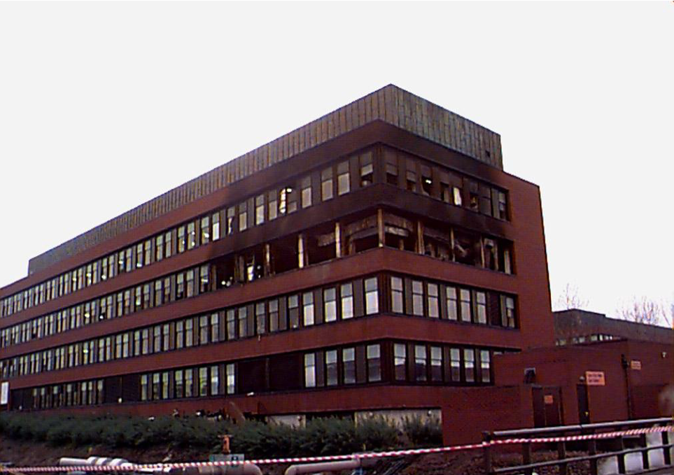
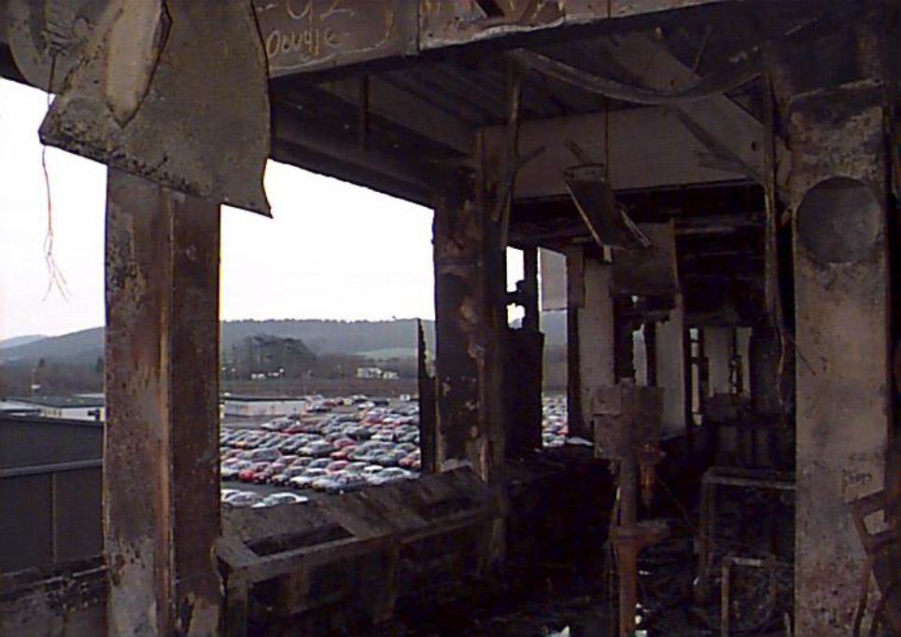
← An example of Correctly Installed Fire Compartmentation
Compartmentation is the method of how the building structure is designed to prevent both the horizontal and vertical spread of fire and smoke. The principal elements of this include:
walls
floors
ceilings
protected shafts – including stairwells, risers etc.
fire doors and shutters
ductwork dampers
fire stopping products
Notes:
Approved Document B: Compartment (fire) A building or part of a building, comprising one or more rooms, spaces or storeys, that is constructed to prevent the spread of fire to or from another part of the same building or an adjoining building.
Compartmentation is vital for buildings such as hospitals to maintain a progressive horizontal evacuation strategy or ‘stay put’ policies.
Compartmentation should keep the fire within the compartment of origin, minimising the impact on residents, and maintaining business continuity.
Compartmentation enables safe escape by protecting escape routes. The compartment containing the fire would be evacuated with residents moved safely to the adjoining compartment.

Slide 10
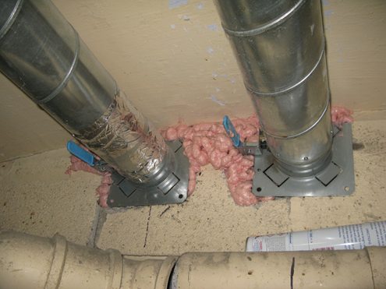
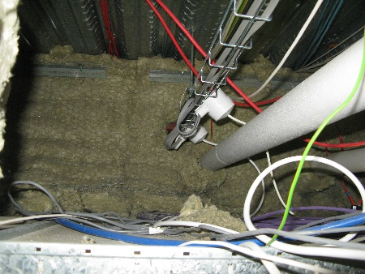
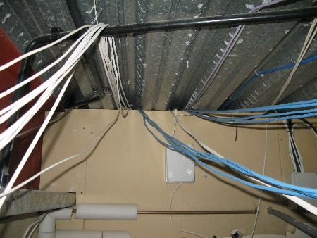
Real life examples
Excessive use of expanding foam around ductwork
Poorly installed fire curtain
Fire breaks not sealed to roof or floor slab
Notes:
Photo 1: Excessive use of expanding foam
Photo 2: Poorly installed fire curtain
Photo 3: Fire breaks not sealed

Slide 11
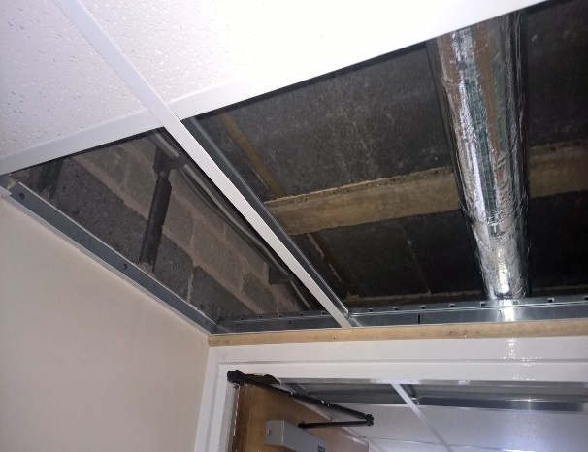
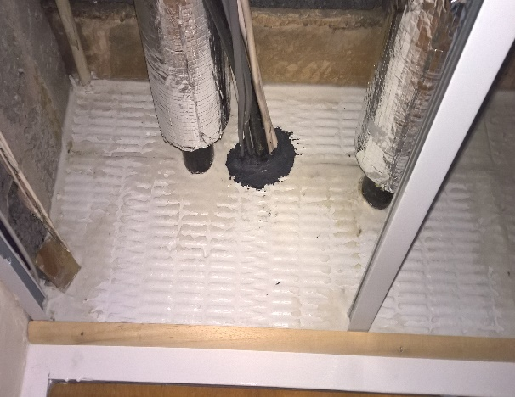
Fire Break over Fire Doors in Residential Care Home
Before – (Nothing there!)
Properly installed ablative board and fire stopping
Notes:
Photo 1 does not have ablative board fitted which would allow a fire to move through the building. With the properly installed board and fire stopping this would be prevented.

Slide 12
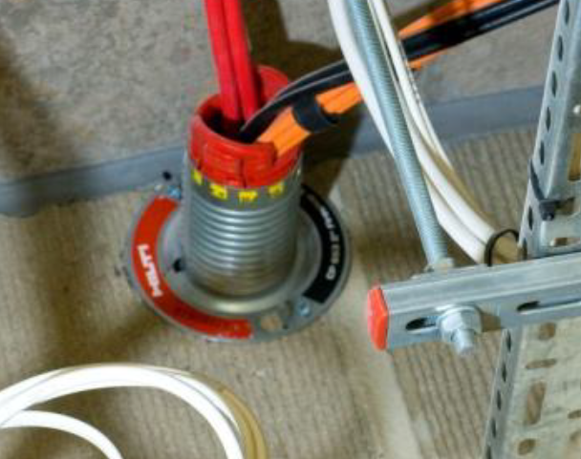
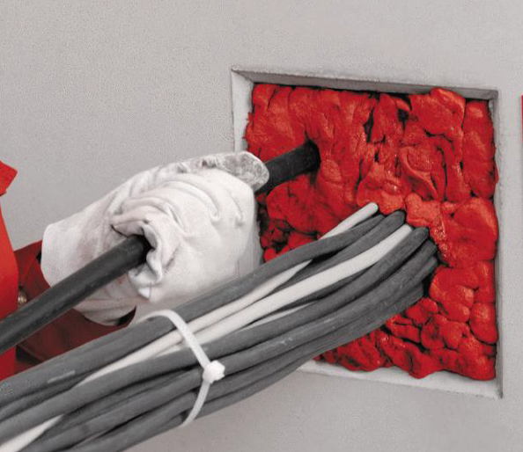
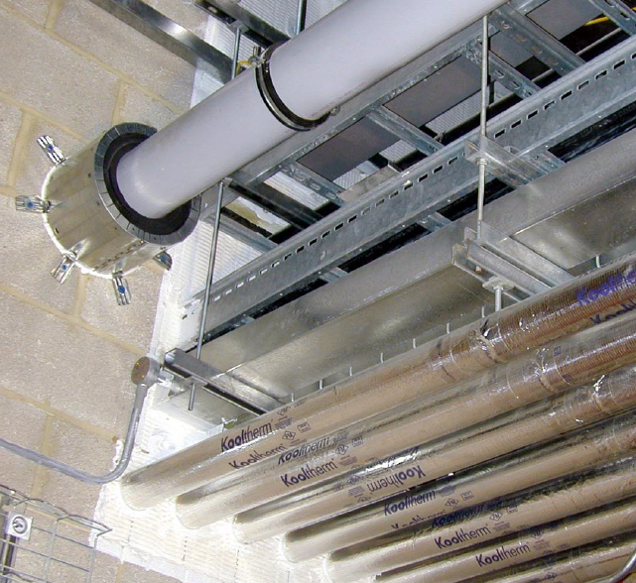
Fire Stopping Installed Correctly
Future-proof Cable Management system
Gun applied fire-stopping solution
Solution for multiple penetrations through wall
Notes:
These are examples of fire stopping installed correctly.
Photo 1: Future- proof cable management system.
Photo 2: Gun applied firestopping solution.
Photo 3: Solution for multiple penetrations through the wall
By firestopping correctly you reduce the possible routes for smoke and flames to move through the building.

Slide 13
SECTION 3
The Role of Fire Doors

Slide 14
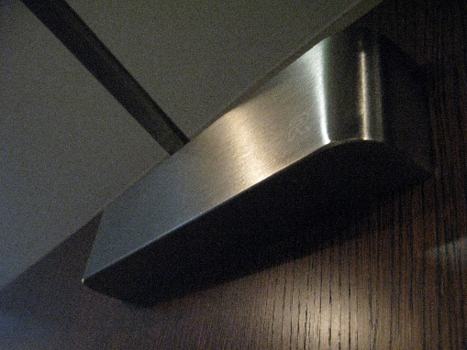
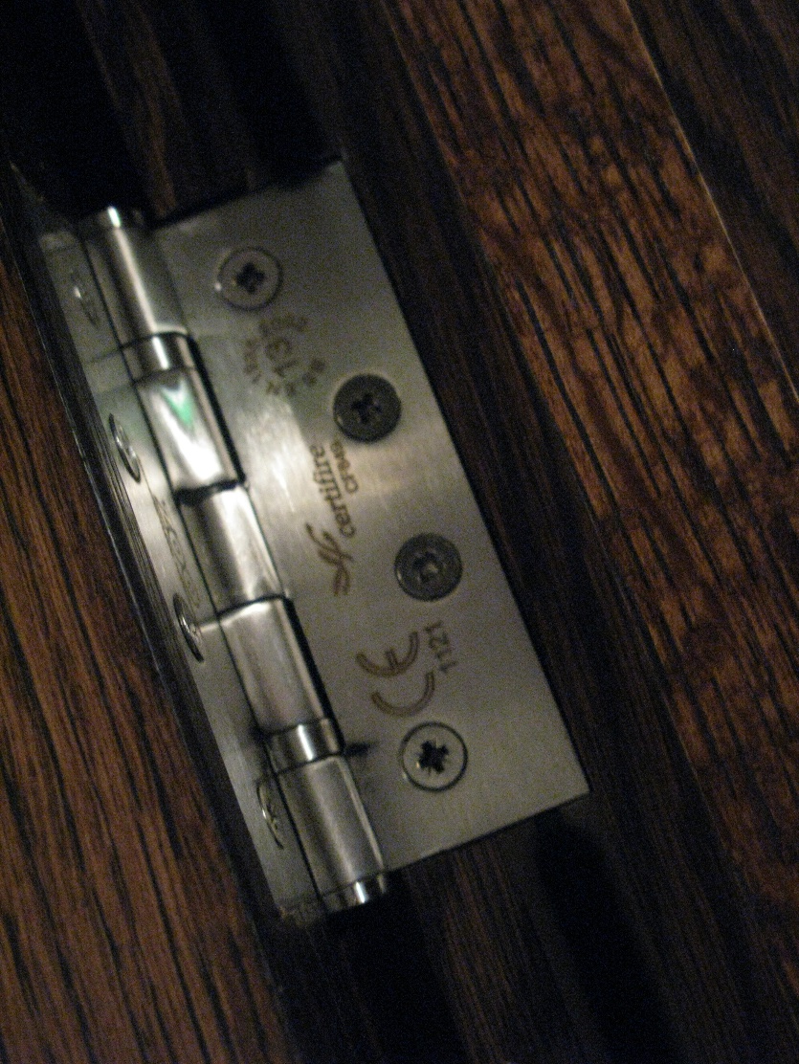
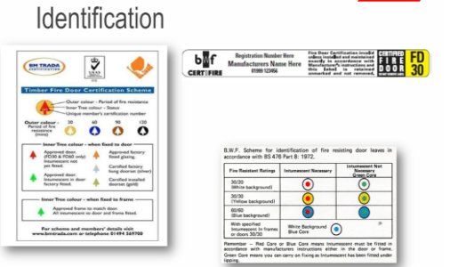
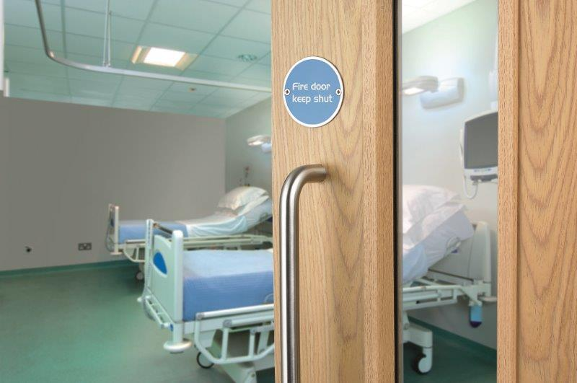
Fire doors consist of three basic elements:
The frame, side panels, over panels and the door leaf
Essential ironmongery
  Hinges
  Closer
  Locks or latches
  Signage
Non-Essential Ironmongery
Notes:
A fire door is not just the door leaf. It is a complete assembly comprising the frame, essential ironmongery such as hinges and closers and non-essential ironmongery such as letter boxes and locks.

Slide 15
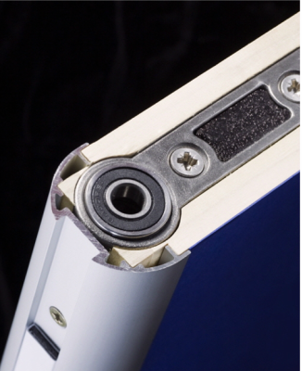
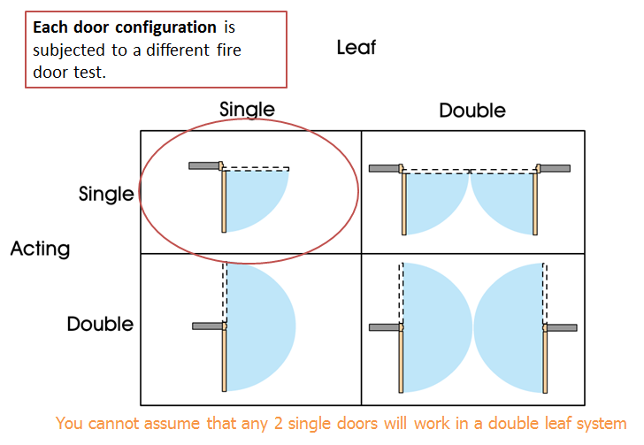
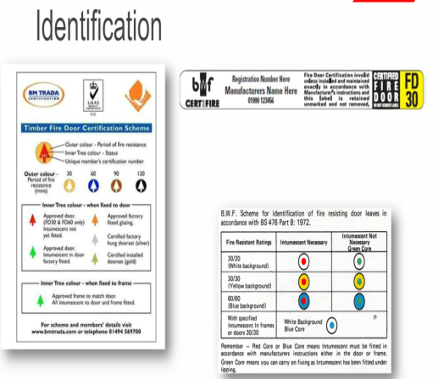
Fire doors are unlike normal doors; they an engineered life saving device and there are standards and regulations that cover products, components and installation.
They must be fire performance tested
You cannot assume that all fire doors are the same
You cannot assume that all door hardware is suitable for fire doors
Notes:
Fire Doors are far more than just a door; they are an engineered life-saving device. They are often overlooked in their role in passive fire protection, but they are an integral part of the building’s compartmentation. Fire doors offer a barrier to hold back a fire and reduce its development by slowing its passage and diminishing the course of the smoke.
They work alongside exit points, escape routes, and compartmentation to provide residents with a route and enough time to exit in a fire and provide firefighters with a level of protection when they enter the building. Depending on the fire rating, fire doors should provide protection from thirty minutes upwards. It is essential that fire doors are correctly installed and maintained to provide a sufficient level of safety.

Slide 16
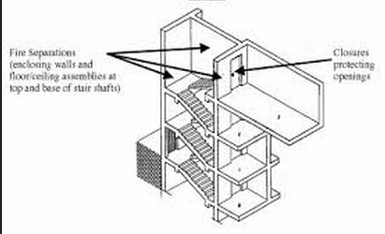
Commonly fire doors are rated FD30 and FD60
Most also provide cold smoke protection (s)
Most made from timber products
Passive fire safety device
Life & Asset Protection
Fire Separation (enclosing walls and floor/celling assemblies at top and base of stair shafts
Closers protecting openings
Notes:
What does FD30 and FD60 mean? These are the most common specification of fire doors leading to escape routes, they resist fire for either 30 or 60 minutes.
The materials used to make up a fire door and how they differ from a non fire rated door. They are usually made of heavy materials such as steel and timber. A normal door usually has the primary purpose of improving room segregation, sound insulation and/or security against intruders rather than retardance to flames, smoke and heat.
A fire door, on the other hand, has achieved a fire-resistance rating signifying its effectiveness in slowing or stopping the spread of fire and smoke throughout a building.
The importance of a fire door – passive fire LIFE SAFETY devise.
Points to consider if you have a fire door installed in your property – only work when closed.

Slide 17
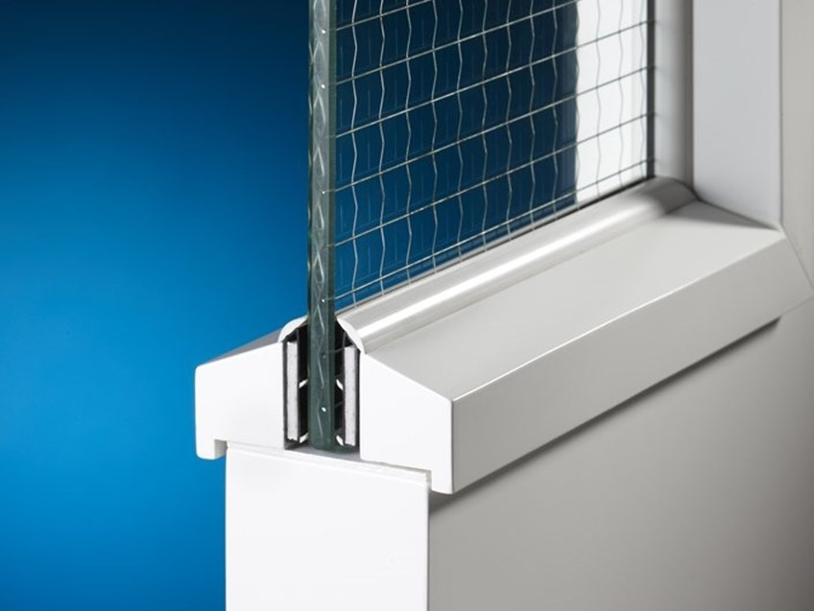
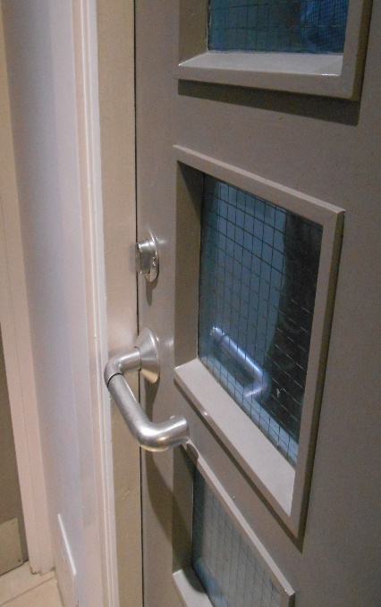
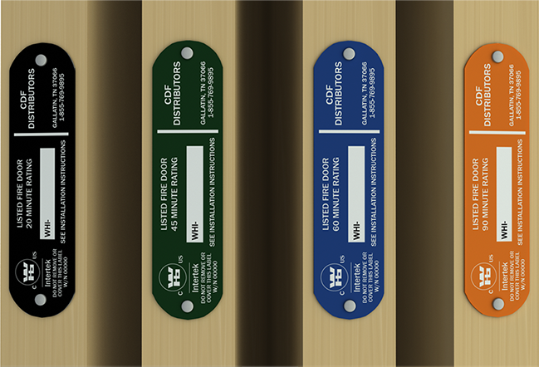
Glazing and Other Openings
Only a certified modifier should add a vision panel or other opening to a fire door
Glass must be fire rated
Air transfer grilles may render a fire door ineffective unless the correct unit is fitted
Notes:
Doors should contain vision panels in both of the following situations. a. Where doors on escape routes divide corridors. b. Where doors are hung to swing both ways.
Fire resisting glass should be marked with the name of the manufacturer and the name of the product. Damaged glassing is to be replaced like-for-like or in accordance with the door manufacturers specification.
Approved Document B states that air transfer grilles should not be fitted in any wall, door, floor or ceiling of the stair enclosure.

Slide 18
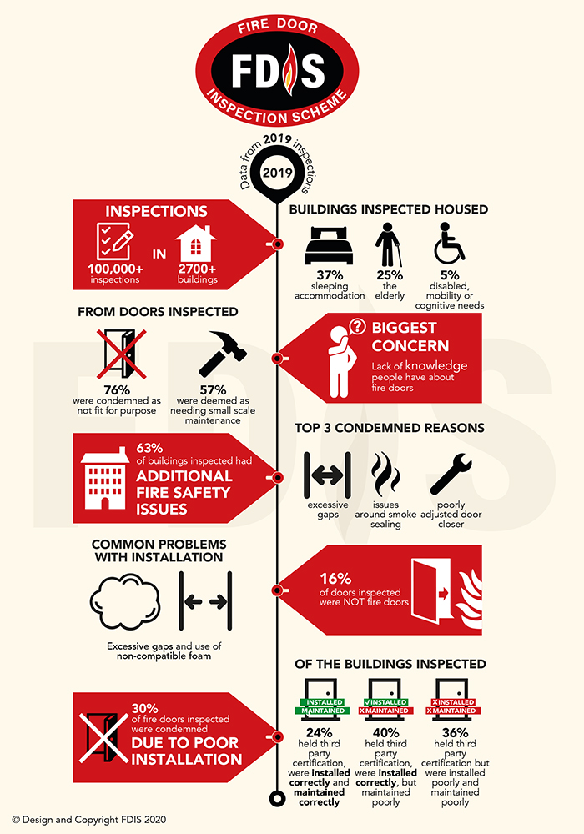
In a survey of FDIS (Fire Door Inspection Scheme) inspectors’ findings:
76% of doors were condemned as not fit for purpose
30% of doors were condemned due to poor installation.
Top 3 condemned reasons:
  Excessive gaps
  Issues around smoke sealing
  Poorly adjusted door closer
Notes:
The Fire Door Inspection Scheme (FDIS) found that more than three quarters (76%) of fire doors it inspected in 2019 were condemned as not fit for purpose.
Further fire safety issues were also found in 63% of the buildings inspected by the FDIS.
The data, which refers to more than 100,000 inspections in over 2,700 buildings across the UK, also highlighted the challenges with fire door installation. 30% of fire doors nationwide were condemned due to poor installation, with problems including excessive gaps around the door and the use of non-compatible foam.

Slide 19
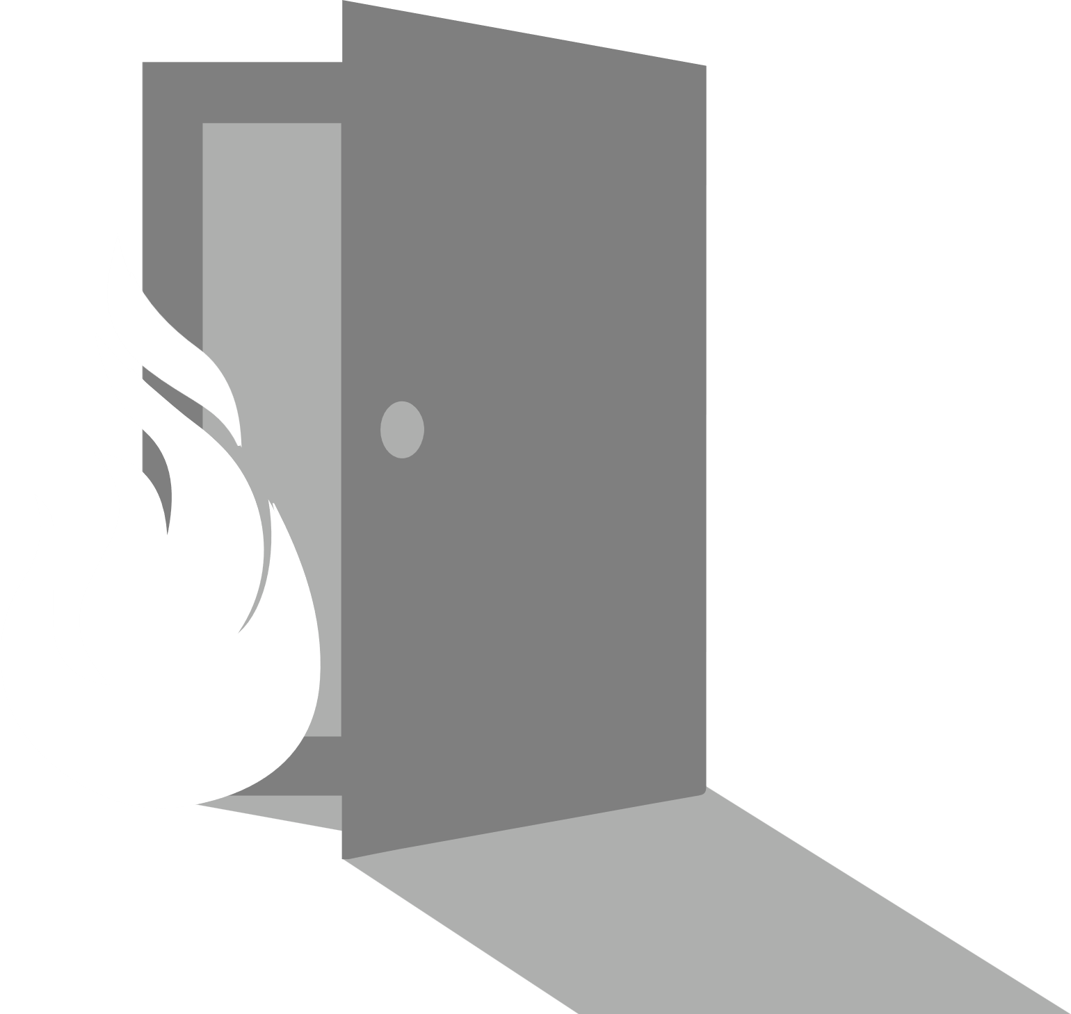
So what’s the word on Escape Doors?
Not usually a fire resisting door (but could be)
Usually, the final exit door used in an emergency to reach place of safety
Predominately there are two types:
  Emergency Escape
  Panic Escape
Notes:
A fire exit door is an external door; it can be left open and does not have to be fire resistant unless it opens out onto or under an external escape stairs or onto certain escape routes. The purpose of the fire exit door is to allow a quick and un-hindered escape through a well lit door into a place of safety while stopping un-authorised access from the outside. Fire exits doors should open easily and, wherever possible, in the direction of traffic flow. If it is a security door that is usually kept locked but will be used by members of the public in an emergency situation, it will have to be fitted with a panic or push bar By enabling the swift passage of people to a place of safety, the final exit door will have performed its function; it does not have to be a fire door to accomplish this. Fire exit doors can also be opened from the outside, if for example a panic bar with a key lock override is fitted. Fire exits must never be obstructed and have to be clearly marked and well lit. Best practice dictates that fire exit signs are fitted above fire exits.
Panic escape doors are usually offers rapid escape in an emergency and is suitable for public areas and place where a situation could rise.

Slide 20
SECTION 4
How to inspect your fire doors (what to look out for)

Slide 21
The process of Fire Door inspections
It is recommended you inspect your doors every 6 months, but high traffic areas may need a visual inspection more frequently
Check:
  There is no damage to the leaf, frame or glazing
  The door is closing correctly
  The smoke seals are intact
  There are no large gaps underneath or between the leaf the frame
Any issues that are highlighted should be dealt with by a competent person
Notes:
CertFDI fire door inspectors will conduct a thorough inspection. They will inspect not just the condition of the doors but the installation, configuration and compatibility of the components.
Door edge gaps - A minimum of 2mm and a maximum of 4mm
Alignment tolerances - Leaves must not be proud of each other or from the door frame by more than 1mm
Threshold = 10mm between the bottom of the leaf and the top of the floor covering – 3mm if a smoke control door
Fire Door check sheet forms should not be issued until confirmation of compliance with regulation 38 is received.

Slide 22
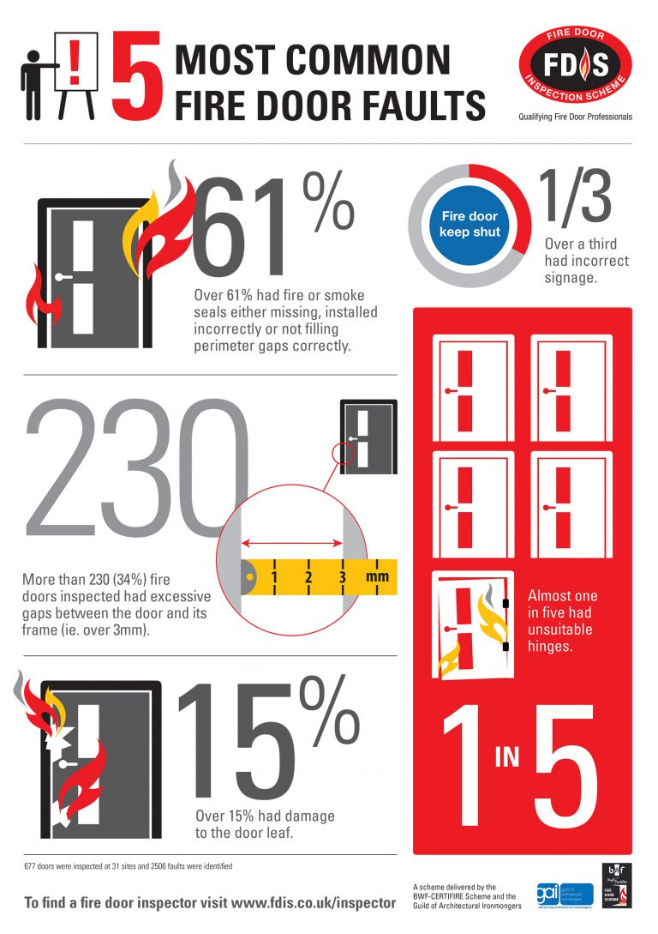
Common faults are:
Fire doors are extremely effective in holding back fire and smoke
They do save lives and protect buildings from further damage
BUT in order to do so they must be installed and maintained correctly. Many are not!
Notes:
Analysis by the FDIS of fire door incpections in the UK revealed the 5 common faults:
Over 61% had problems with fire or smoke seals
More than a third had incorrect signage
230 fire doors inspected had gaps bigger than 3mm between the door and its frame (as specified in BS9999:2008 and BS8214:2008)
More than 20% had unsuitable hinges
Almost 1 in 6 had damage to the door leaf
Faults in doors will mean they are not effective at stopping that passage of fire and smoke which may result in harm to human life.

Slide 23
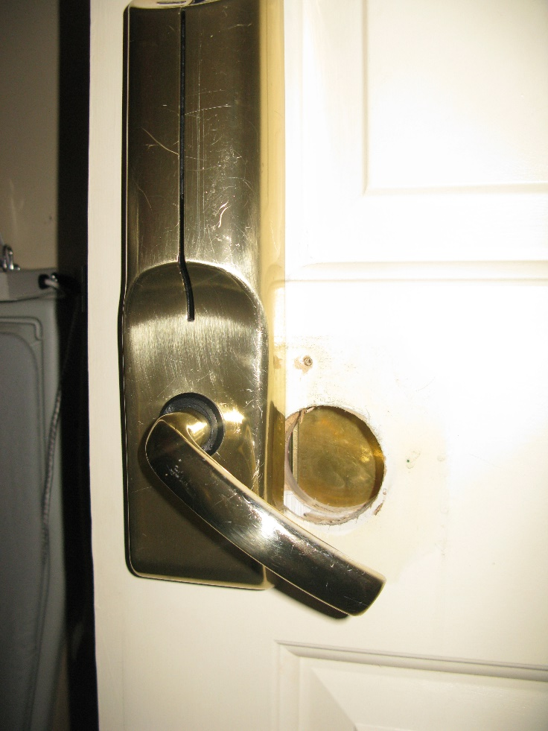
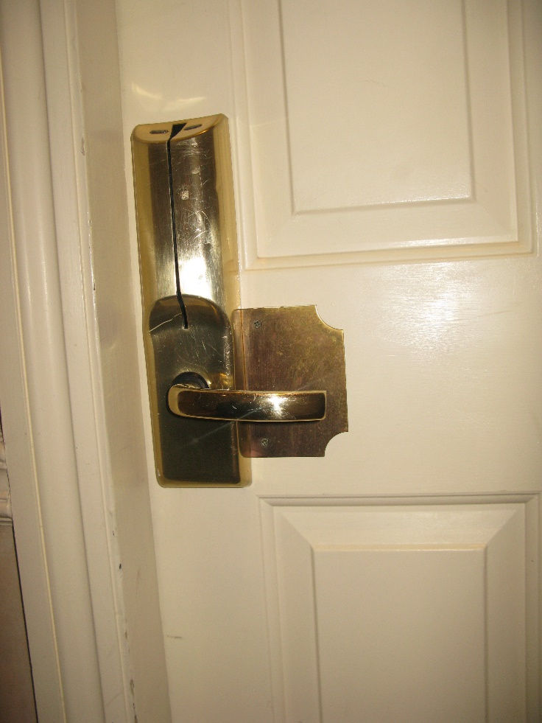
Examples of fire doors that are not compliant
Notes:
Despite efforts to cover the hole in the door, both of these images so non compliance.

Slide 24
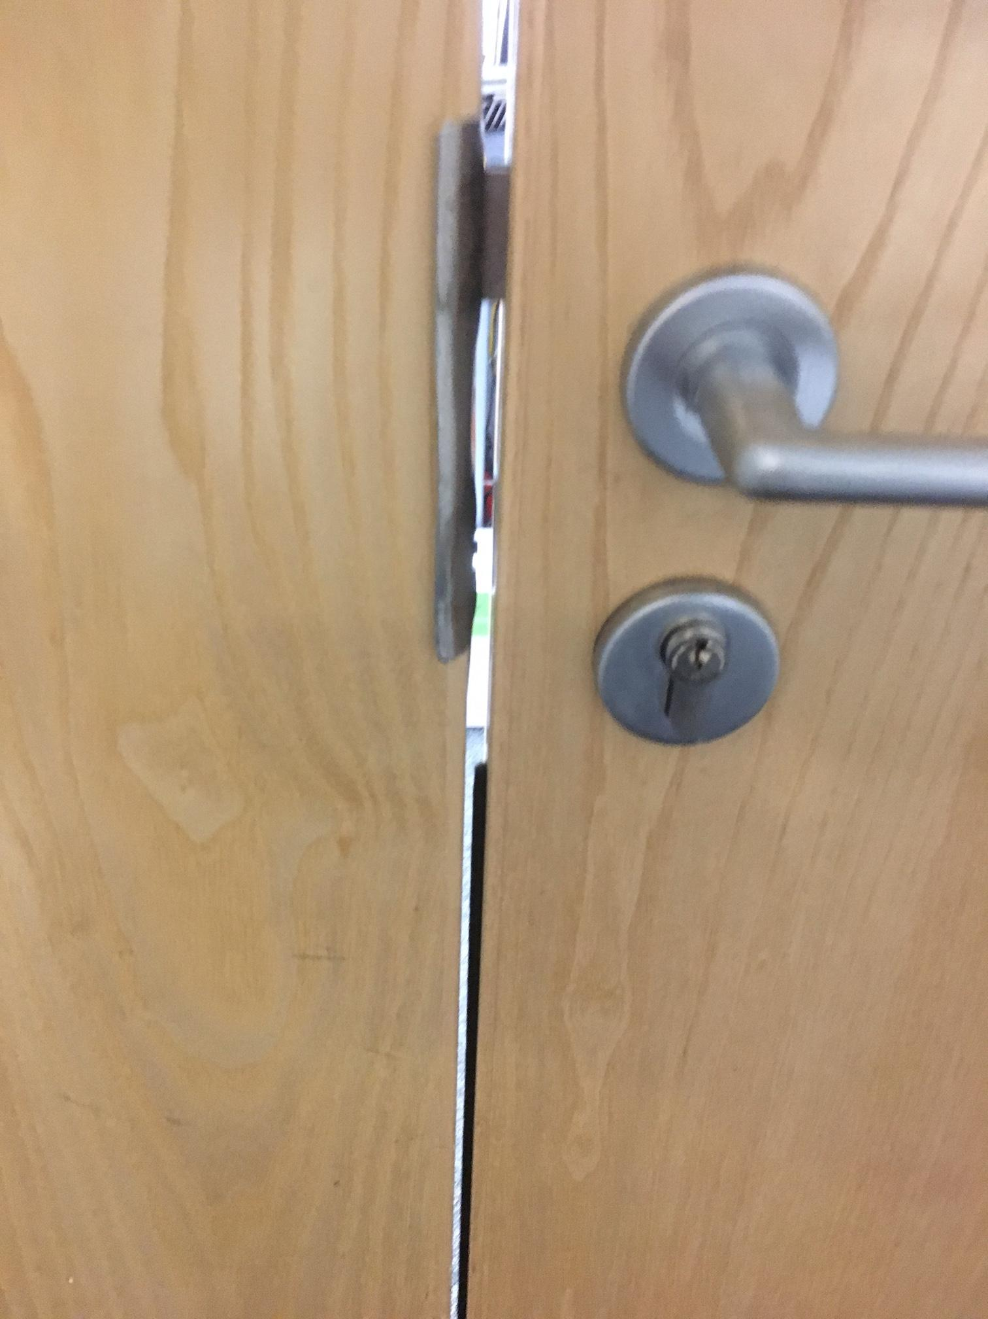
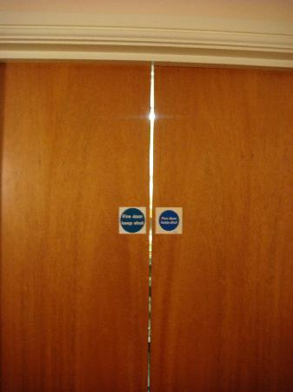
Examples of fire doors that are not compliant
Notes:
The gaps on these doors are above the maximum mm allowed.

Slide 25
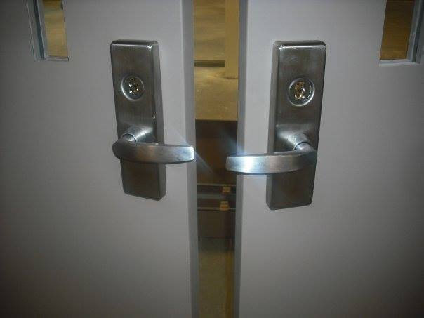
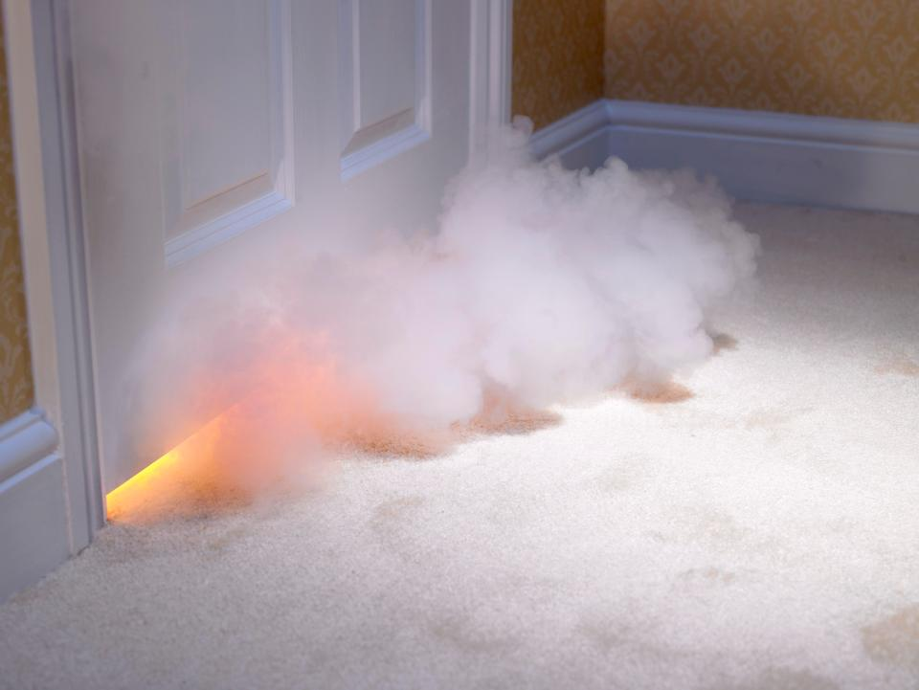
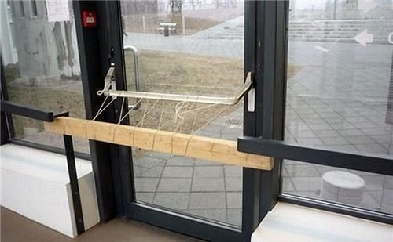
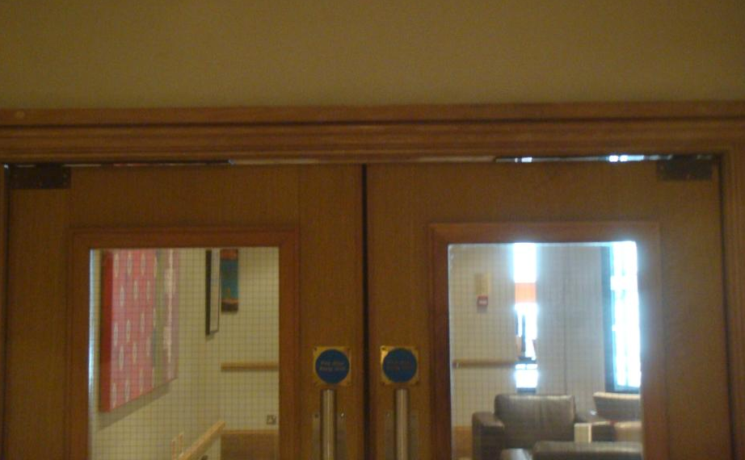
Examples of fire doors that are not compliant
Notes:
More examples of non-compliant doors
Handles facing towards each other
Gaps do not meet requirements allowing the passage of smoke
An emergency exit door wired shut

Slide 26
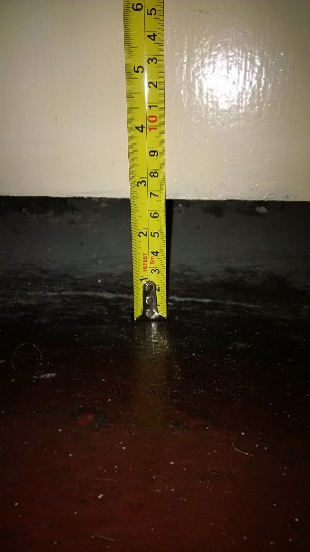
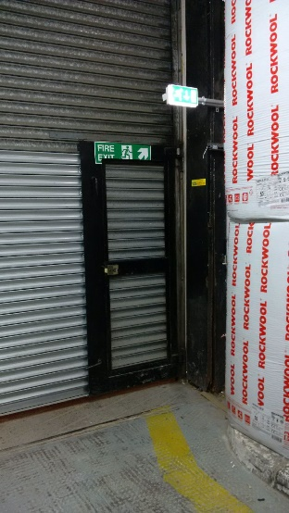
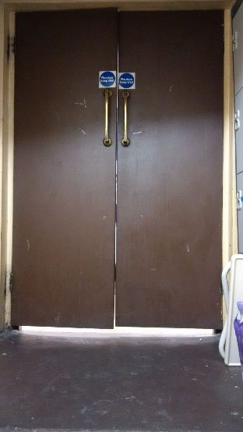
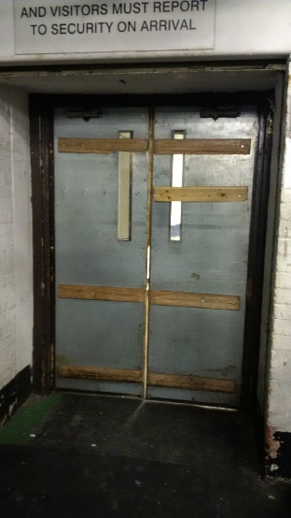
You’ll be surprised how many fire door safety hazards we see on a regular basis!
65mm gap under riser cupboard door
Panic Escape in London Hotel
How effective would these fire doors be?
Back of house doors in another top London hotel
Notes:
These are examples our engineers at Ventro have seen.

Slide 27
SECTION 5
Building Operators Legal Obligations

Slide 28
Building Operator’s Legal Obligations - Overview
In 2005 the ‘Regulatory Reform (Fire Safety) Order was introduced and came into force in 2006.
The RR(FS)O or ‘Fire Safety Order’ applies to virtually all premises other than inside peoples’ private homes.
The Fire Safety Act clarifies that flat entrance doors fall under the domain of the RRO.
It is enforced by Fire & Rescue Services and applies to England and Wales.
Building operators have a legal duty to comply and must appoint a ‘Responsible Person’.
Notes:
The RRO (Regulatory Reform Act, 2005) replaced around 70 separate pieces of legislation that previously governed commercial fire safety. It is intended to ensure that there is a designated person responsible for taking reasonable measures to prevent the outbreak of fire for every building covered by the act. That same person also needs to do everything possible to make sure that occupants can escape safely from the building if a fire ever breaks out.
The law applies to; commercial businesses, shops, offices, care facilities, factories, warehouses, community halls, schools, pubs, restaurants, hostels, and hotels. Significantly, it applies to any business/person that is responsible for the common areas of ‘multi-family housing units’ - including those in high rise apartment blocks.

Slide 29
Building Operator’s Legal Obligations
Building Operator’s Legal Obligations – RRO & Approved Document B
The Regulatory Reform (Fire Safety) Order 2005 states fire doors are a legal requirement in all non-domestic properties, including businesses, commercial premises and public buildings. They’re also required in residential flats and houses of multiple occupancies.
Approved Document B (volume 1) states that in domestic dwellings above two levels, every door leading to the stairwell (at all levels) must be a fire door, where the door leads to a habitable room. (i.e. not a bathroom or w/c). Fire doors are also required in loft conversions; between house and integral garage; and between the business and residential elements in a mixed-use building.
Notes:
Under RRO 2005, you’re the person responsible for fire safety if you are deemed to have control of the premises. For example if you’re:
an employer
the owner of the building
the landlord of the building
a facilities manager, building manager, managing agent, risk assessor, or anyone else with control of the premises.

Slide 30
Building Operator’s Legal Obligations
Building Operator’s Legal Obligations - Fire Safety (England) Regulations 2022
The Fire Safety (England) Regulations 2022 will make it a legal requirement from 23 January 2023 for responsible persons for all multi-occupied residential buildings in England with storeys over 11 metres in height to:
undertake quarterly checks of all fire doors (including self-closing devices) in the common parts
undertake – on a best endeavor basis – annual checks of all flat entrance doors (including self-closing devices) that lead onto a building’s common parts.
The regulations will also require responsible persons to provide to residents of all multi-occupied residential buildings with two or more sets of domestic premises (that have common parts) information on the importance of fire doors to a building’s fire safety.
Notes:
Regulations made under Article 24 of the Regulatory Reform (Fire Safety) Order 2005

Slide 31
ADB 2010, 2019 Addition:
“ Fire Resistance of Doors – All doors that need to be fire-resisting to meet the provisions in the ADB, should have the appropriate performance given in table.
Doors should also meet any limitations on the use of glass”
“Doors on escape routes – Time taken to negotiate a closed door can be critical in escaping. Doors on escape routes (both within and from the building) should therefore be readily openable, if undue delay is to be avoided"

Slide 32
Building Safety Act 2022 – The Accountable Person
The Building Safety Act also seeks to clarify the role and responsibilities of the ‘Accountable Person’. The Accountable Person will have several statutory duties, including:
An ongoing commitment to assessing building safety risks, taking all reasonable steps to prevent the occurrence of a major incident in the building as a result of these risks.
Providing a ‘Safety Case Report’ to demonstrate how building safety risks are being identified, mitigated and managed on an ongoing basis.
Manage fire and structural safety risks in the building day-to-day.
Notes:
Regulations made under Article 24 of the Regulatory Reform (Fire Safety) Order 2005

Slide 33
Building Safety Act 2022 – Types of Buildings the Act Applies To
The reforms being put in place by the Building Safety Act focus on high-rise residential buildings, where the spread of fire or structural flaws can lead to the loss of multiple lives.
This applies to buildings at least 18 metres in height or have at least seven storeys, including two residential units. It also applies to care homes and hospitals meeting the same height threshold during design and construction.
As part of the regulatory planning stage, the Accountable Person will need to consider the different fire equipment suitable for these types of buildings. Some of these include:
Cladding
Sprinkler Systems
Fire Barriers
Fire Doors
Emergency Access
Notes:
Regulations made under Article 24 of the Regulatory Reform (Fire Safety) Order 2005

Slide 34
SECTION 6
Understanding Competence

Slide 35
Competent Person
Article 18 of the Fire Safety Order says the ‘Responsible Person’ must appoint a ‘Competent Person’ as necessary to comply with the law.
When it comes to Passive Fire Protection, the ‘Competent Person’ should be able to demonstrate that they are suitably qualified to inspect, advise on, install, maintain or repair them.
Dame Judith described competency as having the “Knowledge, qualifications, and behaviour.”
Notes:
The law makes reference to the Competent Person as ‘Someone with sufficient training and experience, qualifications and knowledge to be able to implement fire safety measures (some or all) in a building’
Building Safety Bill puts an increasing spotlight on competency

Slide 36



What does a competent Fire Door contractor look like?
BM TRADA Q-Mark qualified
FIRAS Accreditation
Experience with the surveying, installation and maintenance of Fire Doors.
Notes:
A competent fire door contractor should be someone who has sufficient training and experience or knowledge and other qualities that allow them to assist you properly. The level of competence required will depend on the complexity of the situation and the particular help you need. This looks like:
BM Trada qualified
Firas Accredited
A member of FDIS
Has experience with the '3 step approach' surveying, installation and maintenance of fire doors.

Slide 37
SECTION 7
Where to go from here?

Slide 38


Implement a regular inspection of Passive Fire Protection, Fire Doors and Escape Doors as part of the building operator’s Fire Risk Assessment;
Use Competent Persons to inspect, advise on, install, maintain and repair Passive Fire Protection & Fire/Escape Doors.
  Look for a BM Trada, or FDIS (Fire Door Inspection Scheme) certified contractor.
The Exova BM TRADA Scheme is a certification that provides you the reassurance and confidence that your passive fire protection and fire doors are is being installed under a 3rd party product installation scheme which is subjected to a rigorous initial vetting process and regular on-going checks to ensure that the quality of our work continues to meet the standards set by the scheme.
The Fire Door Inspection scheme is a scheme launched as a joint venture between the BWF-Certifire Scheme and the Guild of architectural Ironmongers (GAI). The scheme is to help improve safety, give expert advice, provide vital resources, and to raise awareness of defective fire doors. The scheme provides a comprehensive knowledge in fire door specification, installation, inspection and maintenance, and repair.
Notes:
To make sure your fire doors are compliant and therefore act as a life saving device, you should:
Implement regular inspections
Use a competent person such as a BM Trada or FDIS certified contractor.

Slide 39
Any questions?
ventrogroup.com | Tel: 0345 38 10 999 | Email: contactus@ventrogroup.com

