Slide 1

The current landscape…
The Hackitt Report
The Grenfell Inquiry
The Regulatory Reform (Fire Safety) Order 2005
The Fire Safety Act 2021
Building Regulations 2010
The Housing Act 2004
Smoke and Carbon Monoxide Alarm (England) Regulations 2015 (as amended)
The Building Safety Act 2022
The Fire Safety (England) Regulations 2022
And more?

Slide 2

What does it say?
The Building Safety Regulator and its functions
Regime for the design, construction and works to higher-risk buildings
Regime for the occupation of higher-risk buildings
The New Homes Ombudsman scheme, the rules associated with construction products and the Act’s general application.

Slide 3
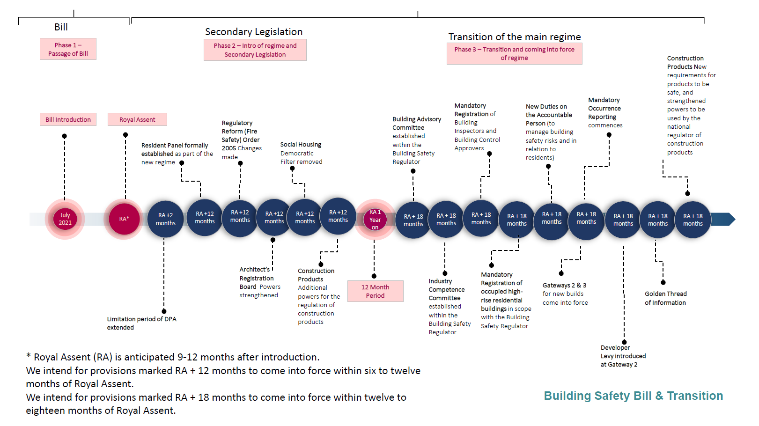

Slide 4
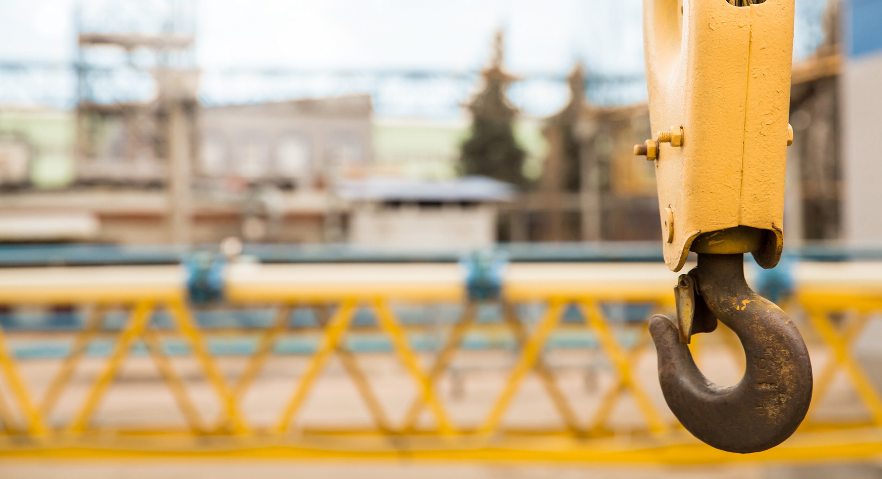
1. Identify the higher-risk buildings
2. Identify the Accountable Persons and the Principal Accountable Persons
3. Register the higher-risk building
4. Appoint a Building Safety Manager or decide to manage the role internally ?
5. Conduct an assessment of the building safety risks
6. Take all reasonable steps as required by the assessment
7. Safety Case Report
8. Establish the mandatory occurrence reporting system and complaints procedure
9. Comply with information sharing and retention obligations
10. Residents Engagement Strategy
11. Apply for Building Assessment Certificate

Slide 5
A HOLISTIC VIEW OF THE RISKS RELATING TO BUILDING SAFETY
The current position – considering risks in silos?
An Accountable Person must promptly take all reasonable steps for (a) preventing a building safety risk materialising as regards the part of the building for which they are responsible; and / or (b) reducing the severity of any incident resulting from such a risk materialising
The Accountable Person must make and give effect to arrangements for the purpose of ensuring the effective planning, organisation, control, monitoring and review of the steps taken

Slide 6

Your Speaker Today
Lorna Kenyon-Pain
Associate
Contact Details
T: 0121 214 3441
E: Lorna.Kenyon-pain@anthonycollins.com

