Slide 1



Carbon Zero Housing
Retrofit Specialists
www.livgreen.co.uk| 0845 646 1566| contact@livgreen.co.uk

Slide 2


What is Retrofit?
Retrofitting is the act of fitting new systems designed for high energy efficiency and low energy consumption to buildings previously built without them.
This can range from small activities such as fitting energy-efficient light bulbs to installing state of the art heating systems.
Key Targets for the Sector:
All Property's to achieve EPC rating of C by 2030
All Property's to by Carbon Zero by 2050.
www.livgreen.co.uk| 0845 646 1566| contact@livgreen.co.uk

Slide 3



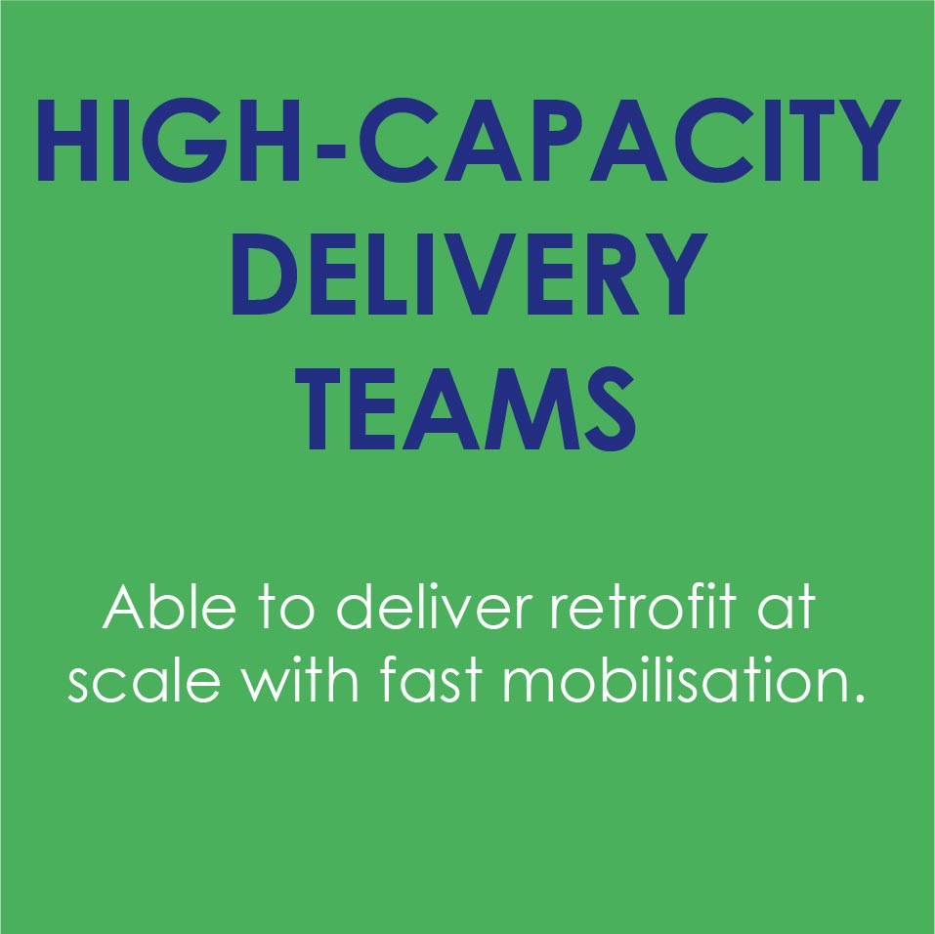

The One-Stop-Shop for Retrofit.
A Specialist Retrofit Contractor with over 13 years' experience delivering projects in the social housing sector. Were a division of the Ventro Group which are 3rd party accredited specialist fire safety contractors.
We provide a specialist one-stop-shop service to assist clients in achieving their zero carbon targets across their housing stock.
www.livgreen.co.uk| 0845 646 1566| contact@livgreen.co.uk

Slide 4


Our 4 Step Approach
Stock Analysis
Assess stock condition and current EPC performance of each property through assessments and surveys.
Design
We design bespoke solutions to ensure our customers key priorities and goals are met to budget.
Delivery
The Installation is an end-to-end project management service from LivGreen. This means you won’t have to deal with or manage installation providers and subcontractors.
Monitoring & Support
We will ensure that we continue to support our customers and residents following the installation with training and maintenance.
www.livgreen.co.uk| 0845 646 1566| contact@livgreen.co.uk

Slide 5







Our Services
Full PAS 2035 Consultancy
General Property Upgrades/Refurbishments
External Wall Insulation
Ventilation Systems
PV Installation
Fabric First Measures: Insulation
Ground Source/Air Source Heat Pumps
EV Charging Points
Energy Efficient Window and Doors
PAS 2035:2019
PAS 2030
www.ventrogroup.com | 0845 38 10 999 | info@ventrogroup.com

