Slide 1
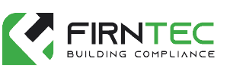

Building Information – Safety Cases
The Building Safety Case
Retrospective Fire Strategy
As-built Fire Safety Drawings
External Wall Assessment - PAS 9980
Fire Risk Assessment e.g. Type 4 FRA
Structural Appraisals
Building Safety Case Retained Consultancy
Building Information
Identifying Building Safety Risks

Slide 2
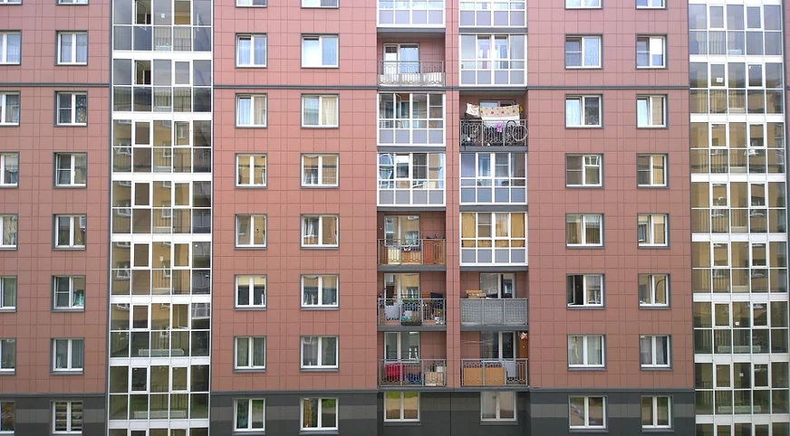
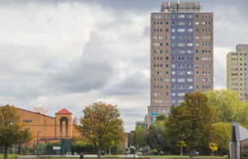
Getting Started – Building the Information
01752 977147 | www.firntec.com | info@firntec.com
Getting started now with Building the Supporting Information
Risks Associated with Old and Inaccurate Information for the Safety Cases.
Not Focusing on just High Rise

Slide 3
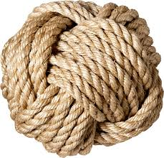

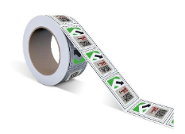
Building and Connecting the Golden Thread
01752 977147 | www.firntec.com | info@firntec.com
Connecting the Golden Thread: Making a Start:
Equipment Asset Tagging
Digitialised CAD Drawings from the beginning
Digitalisation of Information
The Purpose:
- Information stored in one place, in a digital format - easily accessible

