Slide 1
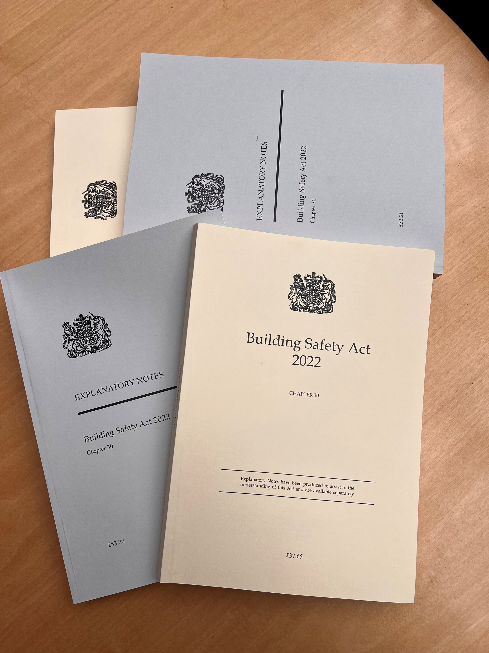
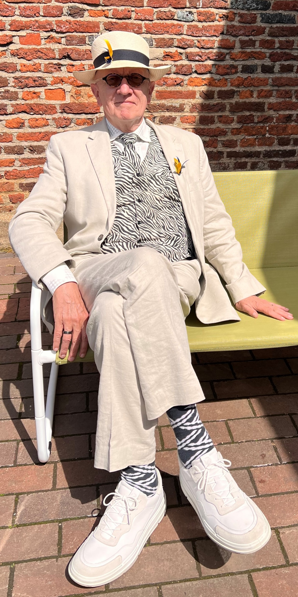
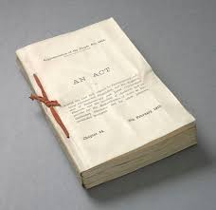

Chris Waterman
Director
Triple A Solutions
chris@3asolutions.tech
+44(0)773 606 9191
www.3asolutions.tech
6-9 The Square
Stockley Park
UB11 1FW
Acting out….
Notes:
This photo was taken just four months ago and how the world has changed since then.

Slide 2

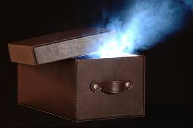
Building Safety Act 2022
Regulations
Guidance
The Hackitt Review
Grenfell Inquiry
DLUCH Committee

Slide 3
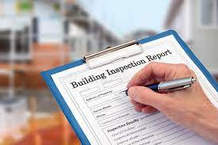
‘DeRegulation, DeRegulation and DeRegulation’
The Building Safety Regulator
  Building Advisory Committee
  Committee on industry competence
  Residents’ Panel
Local authorities
Fire and Rescue authorities

Slide 4
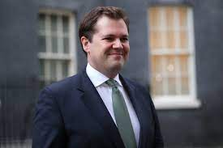

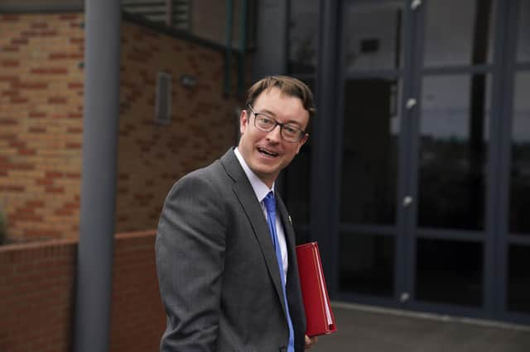

Slide 5
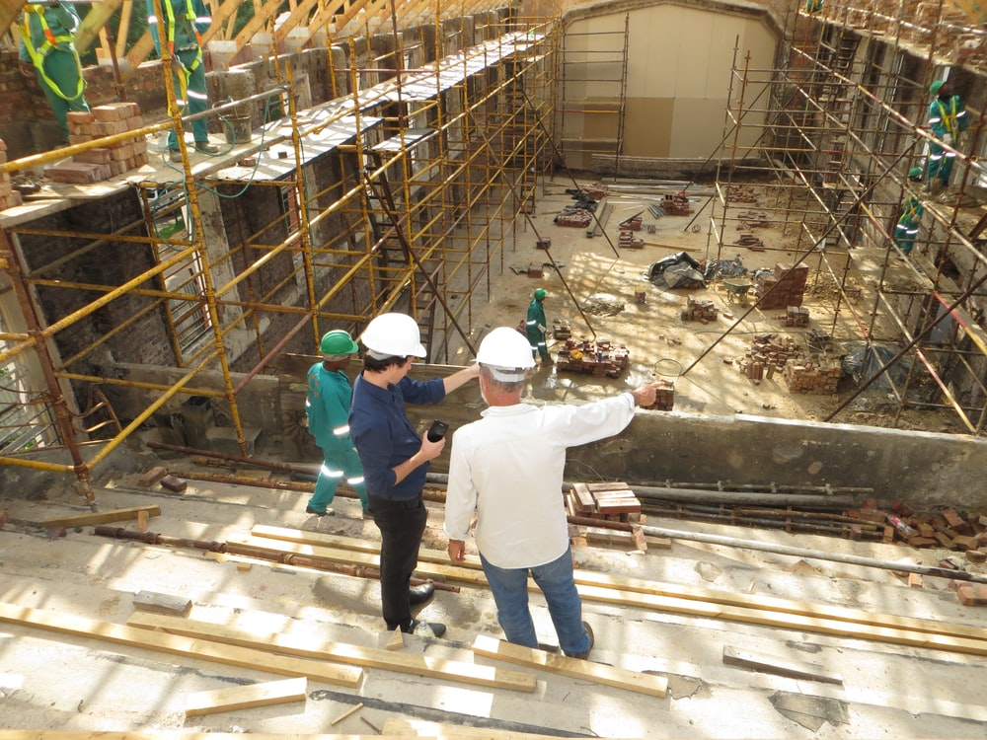
“Never mind the quality, measure the height”
“Could we lop a storey off?
How about a three-storey cellar?

Slide 6

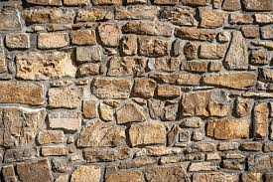
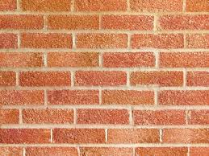
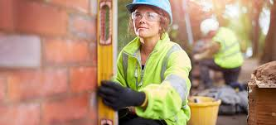
Culture and Competence: from A to B

Slide 7
Where do we go from here?
Chris Waterman
Director
Triple A Solutions
chris@3asolutions.tech
+44(0)773 606 9191
www.3asolutions.tech
6-9 The Square
Stockley Park
UB11 1FW

