Slide 1
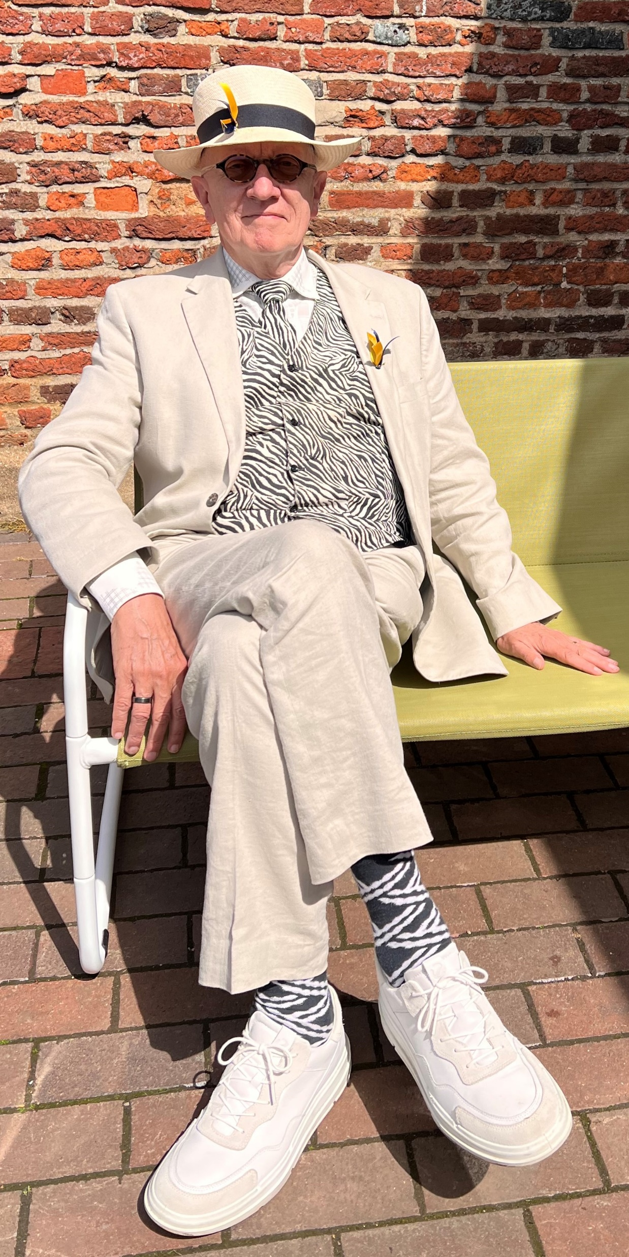


Chris Waterman
Director
Triple A Solutions
chris@3asolutions.tech
+44(0)773 606 9191
www.3asolutions.tech
6-9 The Square
Stockley Park
UB11 1FW
Safety first…

Slide 2
“Women and children first …..”
Education – children with Special Educational Needs
Social care – looked after children
Building safety – individuals with disabilities

Slide 3
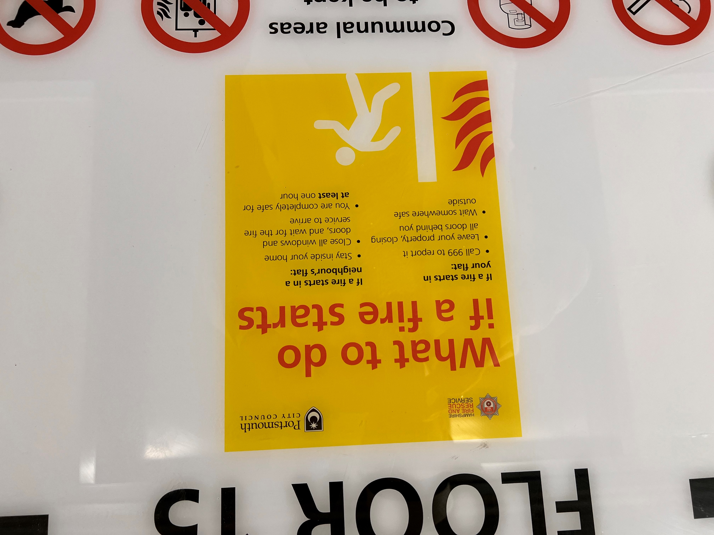
“You are completely safe for at least one hour”

Slide 4
Getting a ‘PEEP’ out of Government
PEEPs are a statutory duty, but more honoured in the breach
Grenfell highlighted the failure to consider residents with disabilities
PEEPs are an additional cost, but this is insignificant compared with other fire prevention measures
Government has consulted and consulted and consulted
But…

Slide 5
Any questions?

Slide 6
